Slide 1
Outline
What is Life made of?
What Molecule Codes For Genes?
What carries information between DNA to Proteins?
How Are Proteins Made? (Translation)
How Do Individuals of a Species Differ?
Why Bioinformatics?
Most materials revised from http://www.bioalgorithms.info

Slide 2
The Cell
A cell is a smallest structural unit of an organism that is capable of independent functioning.
The cell theory states:
All living things or organisms are made of cells and their products.
New cells are created by old cells dividing into two.
Cells are the basic building units of life.

Slide 3
Cells
Chemical composition-by weight
70% water
7% small molecules
salts
Lipids
amino acids
nucleotides
23% macromolecules
Proteins
Polysaccharides
lipids
Function of cells
Secretion (Produce enzymes).
Store sugars or fat.
Brain cells for memory and intelligence.
Muscle cells to contract.
Skin cell to perform a protective coating.
Defense, such as white blood cells.

Slide 4
Prokaryotic Cell
Unicellular organisms, found in all environments.
Without a nucleus; no nuclear membrane (genetic material dispersed throughout cytoplasm ;
No membrane-bound organelles;
Cell contains only one circular DNA molecule contained in the cytoplasm;
DNA is naked (no histone);
Simple internal structure; and
Cell division by simple binary fission.

Slide 5
Eukaryotic Cell
Cell with a true nucleus, where the genetic material is surrounded by a membrane.
Eukaryotic genome is more complex that prokaryotic genome and distributed among multiple chromosomes.
DNA is linear and complexed with histones.
Numerous membrance-bound organelles.
Cell division by mitosis.

Slide 6
All Cells have common Cycles

Slide 7
Signaling Pathways: Control Gene Activity
Instead of having brains, cells make decision through complex networks of chemical reactions, called pathways
Synthesize new materials
Break other materials down for spare parts
Signal to eat or die

Slide 8
Overview of cell signaling

Slide 9
Cells Information and Machinery
Cells store all information to replicate itself
The genome of an organism is the totality of genetic information and is encoded in the DNA (or for some virus, RNA)
Human genome is around 3 billions base pair long
Almost every cell in human body contains same set of genes
But not all genes are used or expressed by those cells
Machinery:
Collect and manufacture components
Carry out replication
(A cell is like a car factory)

Slide 10
Overview of organizations of life
Nucleus = library
Chromosomes = bookshelves
Genes = books
Almost every cell in an organism contains the same libraries and the same sets of books.
Books represent all the information (DNA) that every cell in the body needs so it can grow and carry out its vaious functions.

Slide 11
Some Terminology
Gene: a discrete units of hereditary information located on the chromosomes and consisting of DNA.
basic physical and functional units of heredity.
specific sequences of DNA bases that encode instructions on how to make proteins.
Genotype: The genetic makeup of an organism
Phenotype: the physical expressed traits of an organism
Nucleic acid: Biological molecules(RNA and DNA) that allow organisms to reproduce;

Slide 12
More Terminology
The genome is an organism’s complete set of DNA.
a bacteria contains about 600,000 DNA base pairs
human and mouse genomes have some 3 billion.
human genome has 24 distinct chromosomes.
Each chromosome contains many genes.
Proteins
Make up the cellular structure
large, complex molecules made up of smaller subunits called amino acids.

Slide 13
All Life depends on 3 critical molecules
DNAs
Hold information on how cell works
RNAs
mRNA
Act to transfer short pieces of information to different parts of cell
Provide templates to synthesize into protein
Other types of RNA
rRNA tRNA snRNA miRNA
Proteins
Form enzymes that send signals to other cells and regulate gene activity
Form body’s major components (e.g. hair, skin, etc.)

Slide 14
DNA: The Code of Life
The structure and the four genomic letters code for all living organisms
Adenine, Guanine, Thymine, and Cytosine which pair A-T and C-G on complimentary strands.

Slide 15
DNA, continued
DNA has a double helix structure
The smallest unit of DNA (and RNA) is nucleotide, which composed of
sugar molecule
phosphate group
and a base (A,C,G,T)
DNA always reads from 5’ end to 3’ end for transcription replication
5’ ATTTAGGCC 3’
3’ TAAATCCGG 5’

Slide 16
DNA, RNA, and the Flow of Information
Replication
Transcription
Translation

Slide 17
Overview of DNA to RNA to Protein
A gene is expressed in two steps
Transcription: RNA synthesis
Translation: Protein synthesis

Slide 18
Proteins: Workhorses of the Cell
20 different amino acids
different chemical properties cause the protein chains to fold up into specific three-dimensional structures that define their particular functions in the cell.
Proteins do all essential work for the cell
build cellular structures
digest nutrients
execute metabolic functions
Mediate information flow within a cell and among cellular communities.
Proteins work together with other proteins or nucleic acids as "molecular machines"
structures that fit together and function in highly specific, lock-and-key ways.

Slide 19
What Molecule Codes For Genes?

Slide 20
Outline:
Discovery of the Structure of DNA
Watson and Crick
DNA Basics

Slide 21
Discovery of DNA
DNA Sequences
Chargaff and Vischer, 1949
DNA consisting of A, T, G, C
Adenine, Guanine, Cytosine, Thymine
Chargaff Rule
Noticing #A≈#T and #G≈#C
A “strange but possibly meaningless” phenomenon.
Wow!! A Double Helix
Watson and Crick, Nature, April 25, 1953
Crick Watson

Slide 22
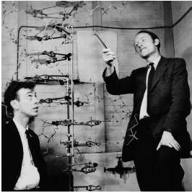
Watson & Crick – “…the secret of life”
Watson: a zoologist, Crick: a physicist
“In 1947 Crick knew no biology and practically no organic chemistry or crystallography..” – www.nobel.se
Applying Chagraff’s rules and the X-ray image from Rosalind Franklin, they constructed a “tinkertoy” model showing the double helix
Their 1953 Nature paper: “It has not escaped our notice that the specific pairing we have postulated immediately suggests a possible copying mechanism for the genetic material.”
Watson & Crick with DNA model
Rosalind Franklin with X-ray image of DNA

Slide 23
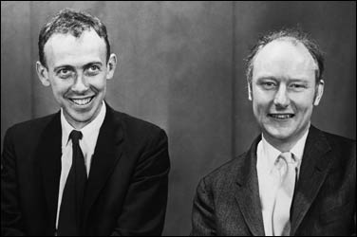
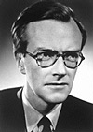
WATSON, J. D. & CRICK, F. H. C. (1953) MOLECULAR STRUCTURE OF NUCLEIC ACIDS. Nature 171
DNA is a double helix structure
1962 Nobel Prize in Physiology or Medicine
Guess how long was the report?

Slide 24
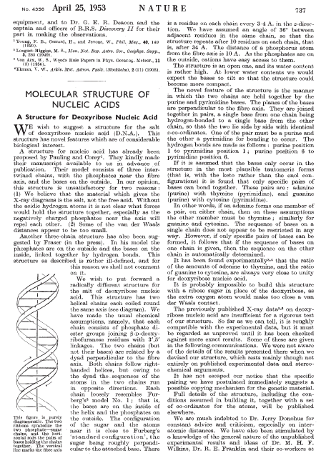
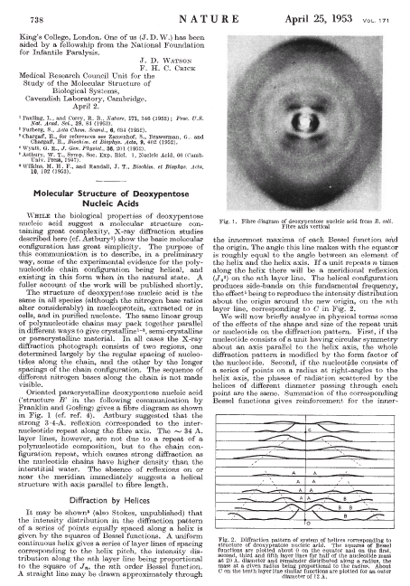
1-page report!!
The original Watson and Crick’s paper

Slide 25
Double helix of DNA
James Watson and Francis Crick proposed a model for the structure of DNA.
Utilizing X-ray diffraction data, obtained from crystals of DNA)
This model predicted that DNA
as a helix of two complementary anti-parallel strands,
wound around each other in a rightward direction
stabilized by H-bonding between bases in adjacent strands.
The bases are in the interior of the helix
Purine bases form hydrogen bonds with pyrimidine.

Slide 26
DNA: The Basis of Life
Deoxyribonucleic Acid (DNA)
Double stranded with complementary strands A-T, C-G
DNA is a polymer
Sugar-Phosphate-Base
Bases held together by H bonding to the opposite strand

Slide 27
DNA, continued
DNA has a double helix structure. However, it is not symmetric. It has a “forward” and “backward” direction. The ends are labeled 5’ and 3’ after the Carbon atoms in the sugar component.
5’ AATCGCAAT 3’
3’ TTAGCGTTA 5’
DNA always reads 5’ to 3’ for transcription replication

Slide 28
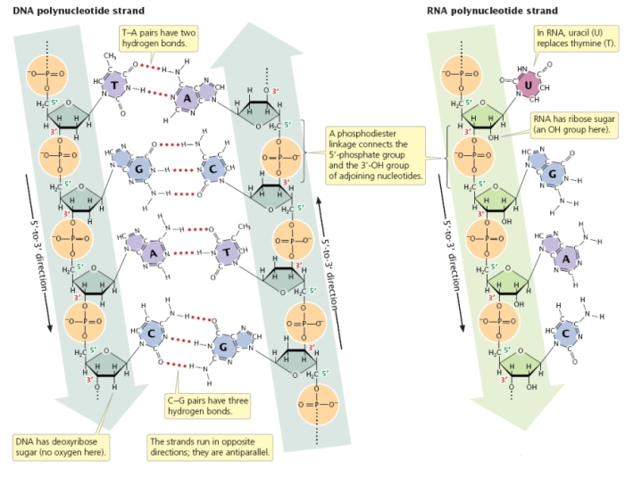

Slide 29
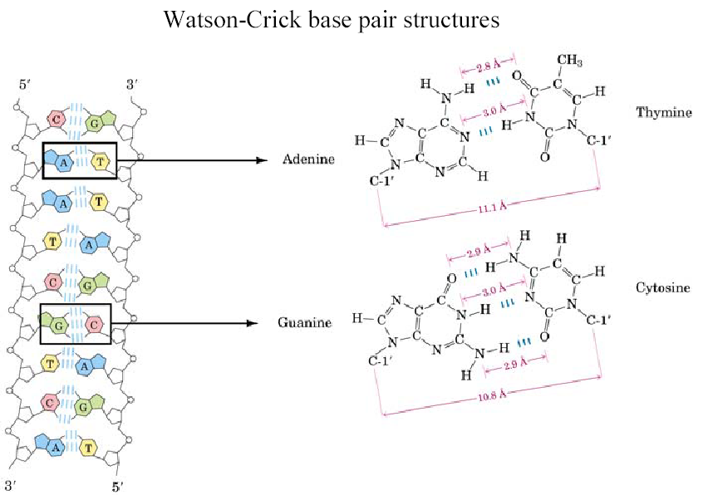
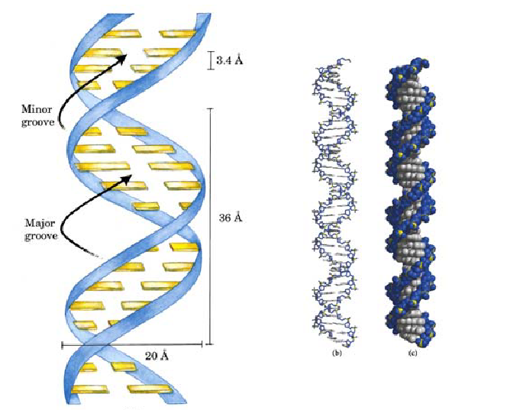
Basic Structure
Phosphate
Sugar

Slide 30
Basic Structure Implications
DNA is (-) charged due to phosphate:
gel electrophoresis, DNA sequencing (Sanger method)
H-bonds form between specific bases: hybridization – replication, transcription, translation
DNA microarrays, hybridization blots, PCR
C-G bound tighter than A-T due to triple H-bond
DNA-protein interactions (via major & minor grooves): transcriptional regulation
DNA polymerization:
5’ to 3’ – phosphodiester bond formed between 5’ phosphate and 3’ OH

Slide 31
Double helix of DNA
The double helix of DNA has these features:
Concentration of adenine (A) is equal to thymine (T)
Concentration of cytidine (C) is equal to guanine (G).
Watson-Crick base-pairing A will only with T, and C with G
base-pairs of G and C contain three H-bonds,
Base-pairs of A and T contain two H-bonds.
G-C base-pairs are more stable than A-T base-pairs
Two polynucleotide strands wound around each other.
The backbone of each consists of alternating deoxyribose and phosphate groups

Slide 32
DNA - replication
DNA can replicate by splitting, and rebuilding each strand.
Note that the rebuilding of each strand uses slightly different mechanisms due to the 5’ 3’ asymmetry, but each daughter strand is an exact replica of the original strand.
http://users.rcn.com/jkimball.ma.ultranet/BiologyPages/D/DNAReplication.html

Slide 33
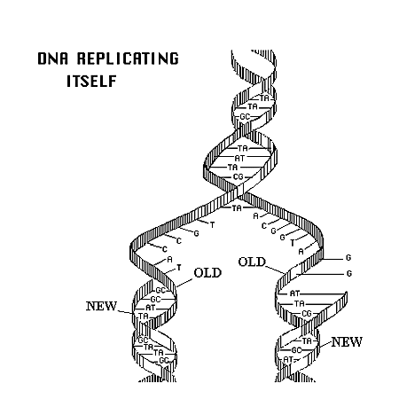
DNA Replication

Slide 34
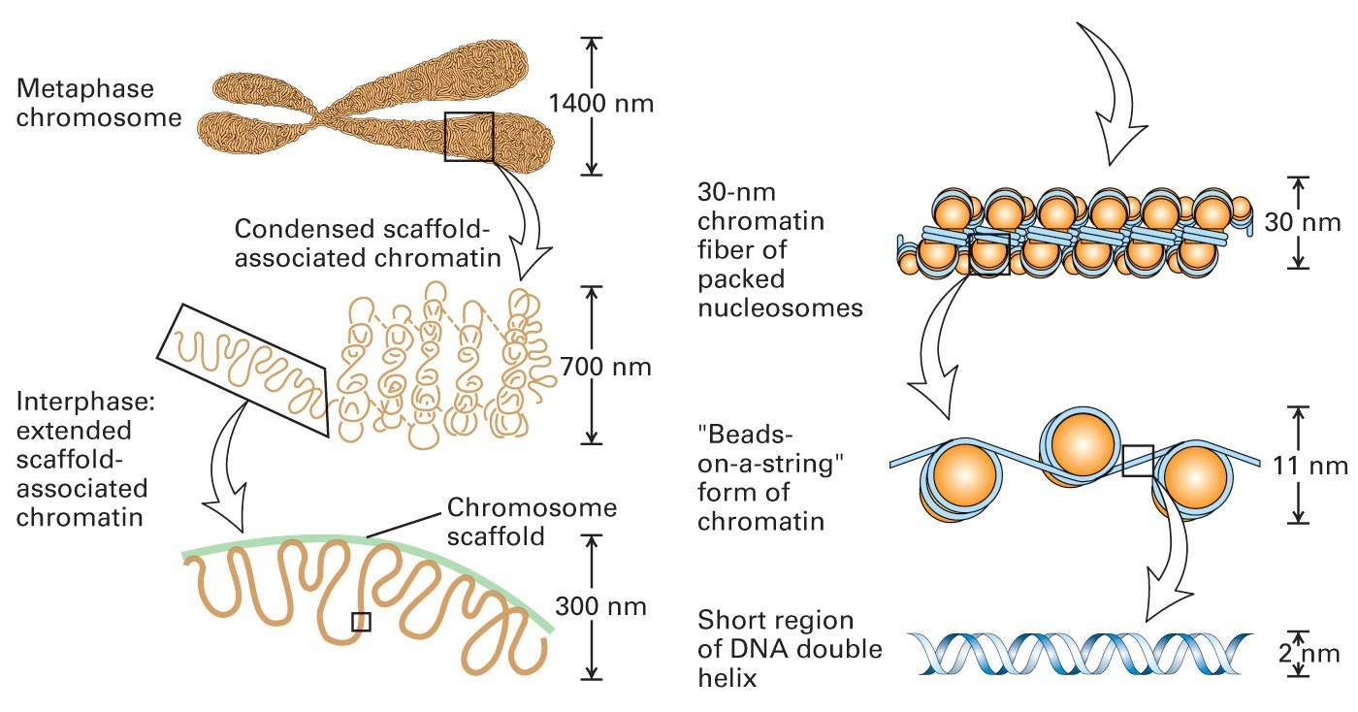
Superstructure
Lodish et al. Molecular Biology of the Cell (5th ed.). W.H. Freeman & Co., 2003.

Slide 35
Superstructure Implications
DNA in a living cell is in a highly compacted and structured state
Transcription factors and RNA polymerase need ACCESS to do their work
Transcription is dependent on the structural state – SEQUENCE alone does not tell the whole story

Slide 36
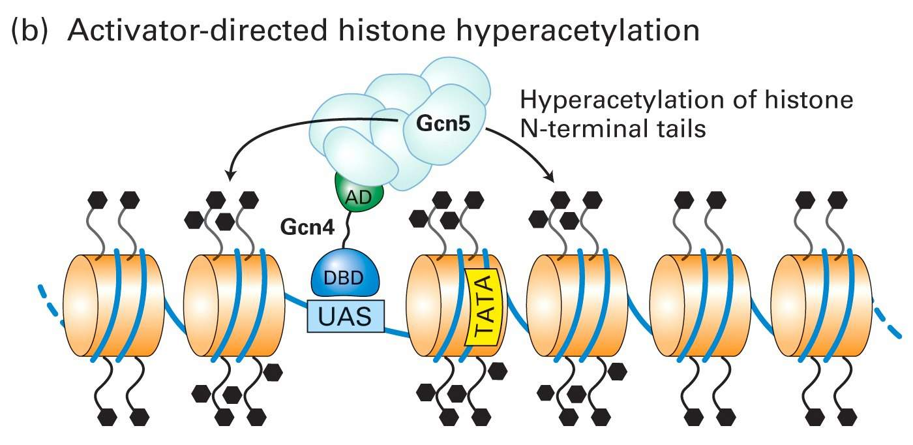
The Histone Code
State of histone tails govern TF access to DNA
State is governed by amino acid sequence and modification (acetylation, phosphorylation, methylation)
Lodish et al. Molecular Biology of the Cell (5th ed.). W.H. Freeman & Co., 2003.

Slide 37
What carries information between DNA to Proteins

Slide 38
Outline
Central Dogma Of Biology
RNA
Transcription
Splicing hnRNA-> mRNA

Slide 39
The central dogma of molecular biology:
DNA
transcription
transcription
transcription
rRNA
(ribosomal)
mRNA
(messenger)
tRNA
(transfer)
Ribosome
translation
Protein

Slide 40
RNA
RNA is similar to DNA chemically. It is usually only a single strand. T(hyamine) is replaced by U(racil)
Some forms of RNA can form secondary structures by “pairing up” with itself. This can have change its properties dramatically.
DNA and RNA
can pair with
each other.
tRNA linear and 3D view:
http://www.cgl.ucsf.edu/home/glasfeld/tutorial/trna/trna.gif

Slide 41
Different types of RNAs
mRNA – this is what is usually being referred to when a Bioinformatician says “RNA”. This is used to carry a gene’s message out of the nucleus.
tRNA – transfers genetic information from mRNA to an amino acid sequence
rRNA – ribosomal RNA. Part of the ribosome which is involved in translation.

Slide 42
Different types of RNAs,continued
miRNA –regulate gene expression.
snRNA– a class of small RNA molecules found within the nucleus. It has the functions of modifying other RNAs: e.g. splicing…

Slide 43
Terminology for Transcription
hnRNA (heterogeneous nuclear RNA): Eukaryotic mRNA primary transcipts whose introns have not yet been excised (pre-mRNA).
Promoter: A special sequence of nucleotides that RNA polymerase and transcription factors bind.
RNA Polymerase II: Multisubunit enzyme that catalyzes the synthesis of an RNA molecule on a DNA template from nucleoside triphosphate precursors.
Terminator: Signal in DNA that halts transcription.

Slide 44
Definition of a Gene
Regulatory regions: up to 50 kb upstream of +1 site
Exons: protein coding and untranslated regions (UTR)
1 to 178 exons per gene (mean 8.8)
8 bp to 17 kb per exon (mean 145 bp)
Introns: splice acceptor and donor sites, junk DNA
average 1 kb – 50 kb per intron
Gene size: Largest – 2.4 Mb (Dystrophin). Mean – 27 kb.

Slide 45
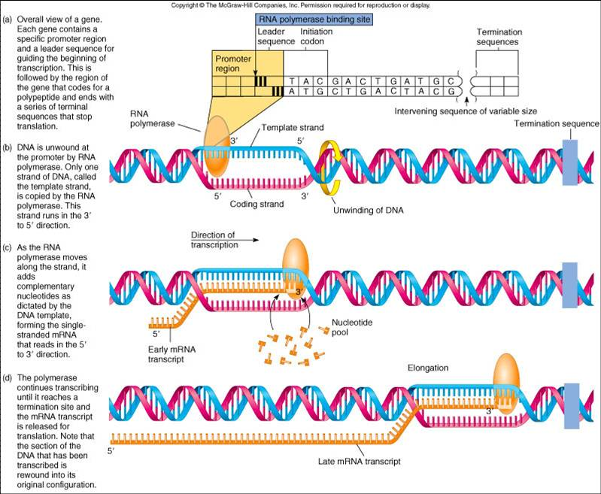
Transcription: DNA → hnRNA

Slide 46
Central Dogma Revisited
Transcription
Splicing
DNA
hnRNA
mRNA
Nucleus
Spliceosome
Translation
protein
Ribosome in Cytoplasm
Base Pairing Rule: A and T or U is held together by 2 hydrogen bonds and G and C is held together by 3 hydrogen bonds.

Slide 47
Terminology for Splicing
Exon: A portion of the gene that appears in both the primary and the mature mRNA transcripts.
Intron: A portion of the gene that is transcribed but excised prior to translation.
Spliceosome: A organelle that carries out the splicing reactions whereby the pre-mRNA is converted to a mature mRNA.

Slide 48
Splicing

Slide 49
Splicing and other RNA processing
In Eukaryotic cells, RNA is processed between transcription and translation.
This complicates the relationship between a DNA gene and the protein it codes for.
Sometimes alternate RNA processing can lead to an alternate protein as a result. This is true in the immune system.

Slide 50
Splicing (Eukaryotes)
Unprocessed RNA is composed of Introns and Extrons. Introns are removed before the rest is expressed and converted to protein.
Sometimes alternate splicings can create different valid proteins.
A typical Eukaryotic gene has 4-20 introns. Locating them by analytical means is not easy.

Slide 51
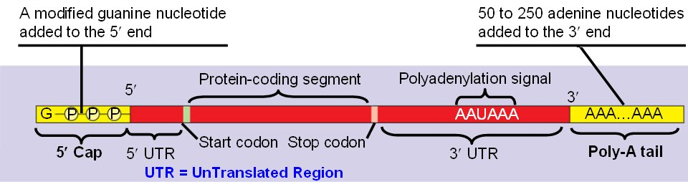
Posttranscriptional Processing: Capping and Poly(A) Tail
A cap of modified guanine triphosphate is added to the 5’ of the RNA.
A poly (A) tail is attached to the 3’end by cleavage downs stream of AAUAAA signal.

Slide 52
Posttranscriptional Processing: Capping and Poly(A) Tail
Protect RNA from degradation.
Poly(A) tail may facilitate the transportation out of nucleus.
Once reach cytoplasm, the modified ends, in conjunction with certain protein, signal a ribosome to attach to the mRNA.

Slide 53
How Are Proteins Made? (Translation)

Slide 54
Outline:
mRNA
tRNA
Translation
Protein Synthesis
Protein Folding

Slide 55
Terminology for Translation
mRNA (messenger RNA): A ribonucleic acid whose sequence is complementary to that of a protein-coding gene in DNA.
Ribosome: The organelle that synthesizes polypeptides under the direction of mRNA
rRNA (ribosomal RNA):The RNA molecules that constitute the bulk of the ribosome and provides structural scaffolding for the ribosome and catalyzes peptide bond formation.
tRNA (transfer RNA): The small L-shaped RNAs that deliver specific amino acids to ribosomes according to the sequence of a bound mRNA.
Codon: The sequence of 3 nucleotides in DNA/RNA that encodes for a specific amino acid.

Slide 56
Terminology for Translation cont’
Anticodon: The sequence of 3 nucleotides in tRNA that recognizes an mRNA codon through complementary base pairing.
C-terminal: The end of the protein with the free COOH.
N-terminal: The end of the protein with the free NH3.

Slide 57
tRNA
The proper tRNA is chosen by having the corresponding anticodon for the mRNA’s codon.
The tRNA then transfers its aminoacyl group to the growing peptide chain.
For example, the tRNA with the anticodon UAC corresponds with the codon AUG and attaches methionine amino acid onto the peptide chain.

Slide 58
The triplet codon

Slide 59
Translation
http://www.youtube.com/watch?v=Ikq9AcBcohA&feature=related

Slide 60
Translation, continued
Catalyzed by Ribosome
Using two different sites, the Ribosome continually binds tRNA, joins the amino acids together and moves to the next location along the mRNA
~10 codons/second, but multiple translations can occur simultaneously
http://wong.scripps.edu/PIX/ribosome.jpg

Slide 61
Uncovering the code
Scientists conjectured that proteins came from DNA; but how did DNA code for proteins?
If one nucleotide codes for one amino acid, then there’d be 4¹ amino acids
However, there are 20 amino acids, so at least 3 bases codes for one amino acid, since 4² = 16 and 4³ = 64
This triplet of bases is called a “codon”
64 different codons and only 20 amino acids means that the coding is degenerate: more than one codon sequence code for the same amino acid

Slide 62
Translation
The process of going from RNA to polypeptide.
Three base pairs of RNA (called a codon) correspond to one amino acid based on a fixed table.
Always starts with Methionine and ends with a stop codon

Slide 63
Terminology for Protein Folding
Endoplasmic Reticulum: Membraneous organelle in eukaryotic cells where lipid synthesis and some posttranslational modification occurs.
Mitochondria: Eukaryotic organelle where citric acid cycle, fatty acid oxidation, and oxidative phosphorylation occur.
Molecular chaperone: Protein that binds to unfolded or misfolded proteins to refold the proteins in the quaternary structure.

Slide 64
Proteins
Complex organic molecules made up of amino acid subunits
20* different kinds of amino acids. Each has a 1 and 3 letter abbreviation.
http://www.indstate.edu/thcme/mwking/amino-acids.html for complete list of chemical structures and abbreviations.
Proteins are often enzymes that catalyze reactions.
Also called “poly-peptides”
*Some other amino acids exist but not in humans.

Slide 65
Polypeptide v. Protein
A protein is a polypeptide, however to understand the function of a protein given only the polypeptide sequence is a very difficult problem.
Protein folding an open problem. The 3D structure depends on many variables.
Current approaches often work by looking at the structure of homologous (similar) proteins.
http://www.sanger.ac.uk/Users/sgj/thesis/node2.html for more information on folding

Slide 66
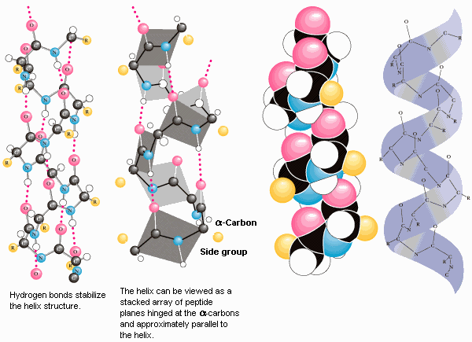
Protein Folding
Proteins tend to fold into the lowest free energy conformation.
Proteins begin to fold while the peptide is still being translated.
Proteins bury most of its hydrophobic residues in an interior core to form an α helix.
Most proteins take the form of secondary structures α helices and β sheets.
Molecular chaperones, hsp60 and hsp 70, work with other proteins to help fold newly synthesized proteins.

Slide 67
Protein Folding
Proteins are not linear structures, though they are built that way
The amino acids have very different chemical properties; they interact with each other after the protein is built
This causes the protein to start fold and adopting it’s functional structure
Proteins may fold in reaction to some ions, and several separate chains of peptides may join together through their hydrophobic and hydrophilic amino acids to form a polymer

Slide 68
Protein Folding (cont’d)
The structure that a protein adopts is vital to it’s chemistry
Its structure determines which of its amino acids are exposed carry out the protein’s function
Its structure also determines what substrates it can react with

Slide 69
Protein Synthesis: Summary
There are twenty amino acids, each coded by three- base-sequences in DNA, called “codons”
This code is degenerate
The central dogma describes how proteins derive from DNA
DNA → mRNA → (splicing?) → protein
The protein adopts a 3D structure specific to it’s amino acid arrangement and function

Slide 70
How Do Individuals of a Species Differ?

Slide 71
Outline:
Physical Variation and Diversity
Genetic Variation

Slide 72
How Do Individuals of Species Differ?
Genetic makeup of an individual is manifested in traits, which are caused by variations in genes
While 99.9% of the 3 billion nucleotides in the human genome are the same, small variations can have a large range of phenotypic expressions
These traits make some more or less susceptible to disease, and the demystification of these mutations will hopefully reveal the truth behind several genetic diseases

Slide 73
The Diversity of Life
Not only do different species have different genomes, but also different individuals of the same species have different genomes.
No two individuals of a species are quite the same – this is clear in humans but is also true in every other sexually reproducing species.
Imagine the difficulty of biologists – sequencing and studying only one genome is not enough because every individual is genetically different!

Slide 74
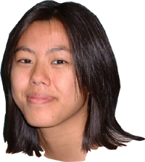
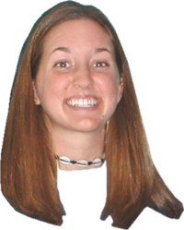
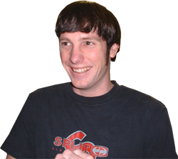
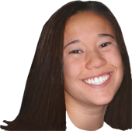
Physical Traits and Variances
Individual variation among a species occurs in populations of all sexually reproducing organisms.
Individual variations range from hair and eye color to less subtle traits such as susceptibility to malaria.
Physical variation is the reason we can pick out our friends in a crowd, however most physical traits and variation can only be seen at a cellular and molecular level.

Slide 75
Sources of Physical Variation
Physical Variation and the manifestation of traits are caused by variations in the genes and differences in environmental influences.
An example is height, which is dependent on genes as well as the nutrition of the individual.
Not all variation is inheritable – only genetic variation can be passed to offspring.
Biologists usually focus on genetic variation instead of physical variation because it is a better representation of the species.

Slide 76
Genetic Variation
Despite the wide range of physical variation, genetic variation between individuals is quite small.
Out of 3 billion nucleotides, only roughly 3 million base pairs (0.1%) are different between individual genomes of humans.
Although there is a finite number of possible variations, the number is so high that we can assume no two individual people have the same genome.
What is the cause of this genetic variation?

Slide 77
Sources of Genetic Variation
Mutations are rare errors in the DNA replication process that occur at random.
When mutations occur, they affect the genetic sequence and create genetic variation between individuals.
Most mutations do not create beneficial changes and some actually kill the individual.
Although mutations are the source of all new genes in a population, they are so rare that there must be another process at work to account for the large amount of diversity.

Slide 78
Sources of Genetic Variation
Recombination is the shuffling of genes that occurs through sexual mating and is the main source of genetic variation.
Recombination occurs via a process called crossing over in which genes switch positions with other genes during meiosis.
Recombination means that new generations inherit random combinations of genes from both parents.
The recombination of genes creates a seemingly endless supply of genetic variation within a species.

Slide 79
Why Bioinformatics?

Slide 80
Why Bioinformatics?
Bioinformatics is the combination of biology and computing.
DNA sequencing technologies have created massive amounts of information that can only be efficiently analyzed with computers.
So far hundreds of species sequenced
Human, rat chimpanzee, chicken, and many others.
As the information becomes ever so larger and more complex, more computational tools are needed to sort through the data.
Bioinformatics to the rescue!!!

Slide 81
Bio-Information
Since discovering how DNA acts as the instructional blueprints behind life, biology has become an information science
Now that many different organisms have been sequenced, we are able to find meaning in DNA through comparative genomics, not unlike comparative linguistics.
Slowly, we are learning the syntax of DNA

Slide 82
Sequence Information
Many written languages consist of sequential symbols
Just like human text, genomic sequences represent a language written in A, T, C, G
Many DNA decoding techniques are not very different than those for decoding an ancient language

Slide 83
Amino Acid Crack
By 1900s, people knew that all proteins are composed of sequences of 20 amino acids
This led some to speculate that polypeptides held the blueprints of life

Slide 84
Central Dogma
DNA mRNA Proteins
DNA in chromosome is transcribed to mRNA, which is exported out of the nucleus to the cytoplasm. There it is translated into protein
Later discoveries show that we can also go from mRNA to DNA (retroviruses).
Also mRNA can go through alternative splicing that lead to different protein products.

Slide 85
Structure to Function
Organic chemistry shows us that the structure of the molecules determines their possible reactions.
One approach to study proteins is to infer their function based on their structure, especially for active sites.

Slide 86
BLAST
A computational tool that allows us to compare query sequences with entries in current biological databases.
A great tool for predicting functions of a unknown sequence based on alignment similarities to known genes.

Slide 87
BLAST

Slide 88
Some Early Roles of Bioinformatics
Sequence comparison
Searches in sequence databases

Slide 89
Biological Sequence Comparison
Needleman- Wunsch, 1970
Dynamic programming algorithm to align sequences

Slide 90
Early Sequence Matching
Finding locations of restriction sites of known restriction enzymes within a DNA sequence (very trivial application)
Alignment of protein sequence with scoring motif
Generating contiguous sequences from short DNA fragments.
This technique was used together with PCR and automated HT sequencing to create the enormous amount of sequence data we have today

Slide 91
Biological Databases
Vast biological and sequence data is freely available through online databases
Use computational algorithms to efficiently store large amounts of biological data
Examples
NCBI GeneBank http://ncbi.nih.gov
Huge collection of databases, the most prominent being the nucleotide sequence database
Protein Data Bank http://www.pdb.org
Database of protein tertiary structures
SWISSPROT http://www.expasy.org/sprot/
Database of annotated protein sequences
PROSITE http://kr.expasy.org/prosite
Database of protein active site motifs

Slide 92
Sequence Analysis
Some algorithms analyze biological sequences for patterns
RNA splice sites
ORFs
Amino acid propensities in a protein
Conserved regions in
AA sequences [possible active site]
DNA/RNA [possible protein binding site]
Others make predictions based on sequence
Protein/RNA secondary structure folding

Slide 93
It is Sequenced, What’s Next?
Tracing Phylogeny
Finding family relationships between species by tracking similarities between species.
Gene Annotation (cooperative genomics)
Comparison of similar species.
Determining Regulatory Networks
The variables that determine how the body reacts to certain stimuli.
Proteomics
From DNA sequence to a folded protein.

Slide 94
Modeling
Modeling biological processes tells us if we understand a given process
Because of the large number of variables that exist in biological problems, powerful computers are needed to analyze certain biological questions

Slide 95
Protein Modeling
Quantum chemistry imaging algorithms of active sites allow us to view possible bonding and reaction mechanisms
Homologous protein modeling is a comparative proteomic approach to determining an unknown protein’s tertiary structure
Predictive tertiary folding algorithms are a long way off, but we can predict secondary structure with ~80% accuracy.
The most accurate online prediction tools:
PSIPred
PHD

Slide 96
Regulatory Network Modeling
Micro array experiments allow us to compare differences in expression for two different states
Algorithms for clustering groups of gene expression help point out possible regulatory networks
Other algorithms perform statistical analysis to improve signal to noise contrast

Slide 97
Topics in Bioinformatics
Sequence analysis
Protein folding, interactions and modelling (structural genomics)
High-throughput experimental data analysis: Microarray; Mass Spectrometry
Comparative genomics
Regulatory network modeling; Systems Biology
Database exploration and management

Slide 98
The future…
Bioinformatics is a dynamic and evolving field.
Much is still to be learned about how proteins can manipulate a sequence of base pairs in such a peculiar way that results in a fully functional organism.
How can we then use this information to benefit humanity without abusing it?

Slide 99
R is a free software environment for statistical computing and graphics (www.r-project.org). Download and install the package. Download tutorial files from course web (http://www.biostat.pitt.edu/biost2055/11) and practice.

Slide 100
Review slides of basic molecular biology if you are not familiar with it.
Download and install R software. Follow the tutorial and practice basic operation in R. (On 1/18, we’ll have the first computer lab session and homework using R)

