Slide 1
Supervised machine learning
01/24/2012

Slide 2
Agenda
0. Introduction of machine learning
--Some clinical examples
Introduction of classification
1. Cross validation
2. Over-fitting
Feature (gene) selection
Performance assessment
Case study (Leukemia)
Sample size estimation for classification
Common mistake and discussion
Classification methods available in R packages

Slide 3
Statistical Issues in Microarray Analysis
Experimental design
Image analysis
Preprocessing
(Normalization, filtering,
MV imputation)
Data visualization
Regulatory network
Identify differentially
expressed genes
Gene enrichment
analysis
Clustering
Classification
Integrative analysis &
meta-analysis

Slide 4
0. Introduction to machine learning
A very interdisciplinary field with long history.
Statistics
Applied Math
Computer Science
& Engineering
Machine learning
CMU 10-701 - Machine Learning
CMU 10-702 - Statistical Machine Learning

Slide 5
0. Introduction to machine learning
Classification (supervised machine learning):
With the class label known, learn the features of the classes to predict a future observation.
The learning performance can be evaluated by the prediction error rate.
Clustering (unsupervised machine learning)
Without knowing the class label, cluster the data according to their similarity and learn the features.
Normally the performance is difficult to evaluate and depends on the content of the problem.

Slide 6
0. Introduction to machine learning

Slide 7
0. Introduction to machine learning

Slide 8
0. Introduction to machine learning

Slide 9
1. Introduction to classification
Data: Objects {X_{i}, Y_{i}}(i=1,…,n) i.i.d. from joint distribution {X, Y}. Each object X_{i} is associated with a class label Y_{i}∈{1,…,K}.
Method: Develop a classification rule C(X) that predicts the class label Y well. ( error rate: #{i: Y_{i}≠C(X_{i})} )
How is the classifier learned from the training data generalize to (predict) a new example.
Goal: Find a classifier C(X) with high generalization ability.
In the following discussion, only consider binary classification (K=2).

Slide 10
Difference between DE gene detection and supervised machine learning (classification analysis)
DE gene detection:
Identify “all” genes that are differentially expressed across conditions.
Purpose: Identify candidate markers (may be hundreds). Understand disease mechanism.
Supervised machine learning:
Construct a “prediction model” that can predict future patients/samples.
Purpose: Predict future patients. Usually only care about prediction accuracy and model interpretability.

Slide 11
Some clinical examples and commercialized products

Slide 12
Molecular Biomarker and Genomic Tests
Couzin (2007) reported that, amid debate, gene-based cancer test was approved.
With the hope of developing individualized treatment, it is hypothesized that using genomic tests in addition to traditional methods will result in more accurate risk assessment, especially when the diseases may be heterogeneous due to underlying genomic characteristics.
genomic-based ⬄ cell-based

Slide 13
Breast Cancer Studies
It was hypothesized that by using newly developed gene-signature tools one can identify subgroup of patients who will respond significantly to post-surgery (adjuvant) chemotherapy.
A parallel goal is to identify what is the best treatment for patients: chemotherapy or hormonal therapy.

Slide 14
Evaluation of Accuracy of Biomarkers
Pepe, Feng, et al (2008) discussed standards for evaluation of the accuracy of a biomarker used for classification or prediction.
Prospective-specimen-collection, retrospective-blinded-evaluation (PRoBE)
Specimens are collected prospectively from a cohort that represents the target population that is envisioned for clinical application of the biomarker.

Slide 15
Evaluation of Biomarkers (continue)
Specimens and clinical data are collected in the absence of knowledge about patient outcome.
After outcome status is ascertained, case patients with the outcome and control subjects without it are selected randomly from the cohort and their specimens are assayed for the biomarker in a fashion that is blinded to case-control status.

Slide 16
ASCO 2007 Guidelines
The American Society of Clinical Oncology (ASCO) published the 2007 update of recommendations for the use of tumor markers in breast cancer.
A new topic is multi-parameter gene expression analysis for breast cancer.
The Oncotype DX, the MammaPrint test, the Rotterdam Signature, and the Breast Cancer Gene-expression Ratio were discussed.

Slide 17
MammaPrint (70-Gene Signature)
A gene expression profile using a DNA microarray platform marketed by Agendia in the Netherlands.
Requires a sample of tissue that is composed of a minimum of 30% malignant cells.
Received FDA clearance and is available in Europe and the United States.

Slide 18
MammaPrint

Slide 19
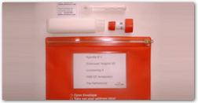
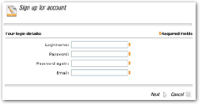
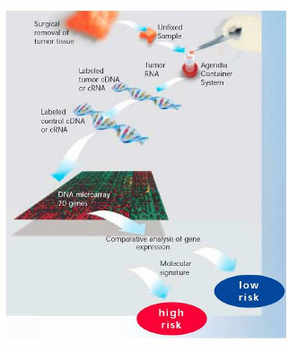
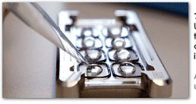
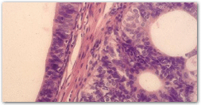
MammaPrint

Slide 20
MammaPrint (development)
Developed on the basis of research conducted at the Netherlands Cancer Institute in Amsterdam and collaborating institutions (van't Veer et al 2002)
Using microarray technology and samples from lymph node-negative breast cancers, a dichotomous risk classifier was developed.

Slide 21
MammaPrint (the study)
Of 117 patients, 78 sporadic lymph-node-negative patients were selected to search for a prognostic signature in their gene expression profiles.
44 Patients remained free of disease after their initial diagnosis for an interval of at least 5 years (good prognosis group), and 34 patients had developed distant metastases within 5 years (poor prognosis group).

Slide 22
MammaPrint (selection of genes)
Using supervised classification method, approximately 5000 genes were selected from the 25,000 genes on the microarray.
Among them, 231 genes were found to be significantly correlated with disease outcome (distant metastases within 5 years).
These 231 genes were ranked and then the top 70 genes were selected.

Slide 23
MammaPrint (initial performance)
An additional set of tumors from patients free from distant metastases for at least 5 years after diagnosis and 12 tumors from patients with metastases within 5 years of diagnosis were analyzed.
The 70-gene profile accurately predicted disease outcome in 17 of 19 patients, thereby confirming the initial performance of the prognostic classifier (Mook, Van’t Veer, et al 2007).

Slide 24
MammaPrint (validation)
A retrospective validation of the 70-gene profile was performed by the same Dutch group using a consecutive series of 295 breast cancer patients (144 lymph node positive and 151 lymph node negative, Cardoso, Van't Veer, et al 2009).
Another independent retrospective validation study was done by Buyse et al (2006). They used tumor from 302 node-negative patients from five non-Dutch cancer centers in UK, Sweden and France. Their results confirmed that the 70-gene profile was able to discriminate between high risk and low risk patients.

Slide 25
MammaPrint

Slide 26
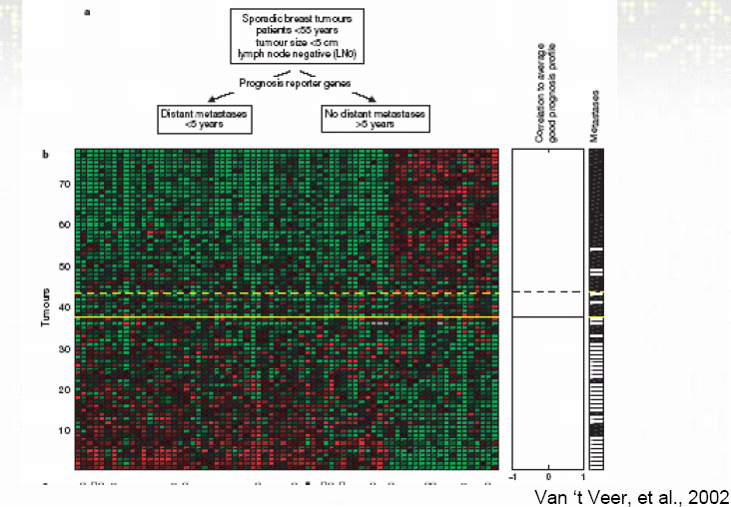
MammaPrint

Slide 27
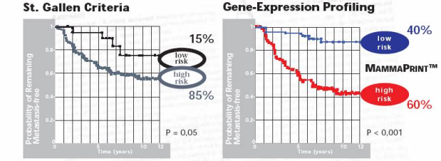
MammaPrint
Gene expression diagnosis is better than traditional clinical parameters.

Slide 28
Tamoxifen and Chemotherapy?
Large clinical trials have demonstrated the benefit of tamoxifen and chemotherapy in women who have node negative, estrogen-receptor positive breast cancer.
Since the likelihood of distant recurrence in patients treated with tamoxifen alone after surgery is about 15 percent at 10 years, at least 85 percent of patients would be overtreated with chemotherapy if it were offered to everyone.

Slide 29
Oncotype DX (21-gene Recurrence Score)
Using RT-PCR technique, Paik et al (2004) reported that the results of the assay of 21 prospectively selected genes in paraffin-embedded tumor tissue correlated with the likelihood of distant recurrence.
The levels of expression of 16 cancer related genes and 5 reference genes were used in a prospectively defined algorithm given by Paik et al (2004) to calculate a recurrence score (RS) and to determine a risk group

Slide 30
Oncotype DX (21-gene Recurrence Score)
Oncotype DX measures the expression of ER and HER2, as well as that of ER-regulated transcripts and other genes associated with outcome.
Sparano and Paik (2008) reported that the Oncotype DX assay has been ordered for more than 40,000 patients and by approximately 6000 different physicians since it became commercially available in January 2005.

Slide 31
Rotterdam 76-gene Signature
Using Affymetrix Human U133a GeneChips, Wang, Klijn, et al (2005) analyzed frozen tumor samples from 286 lymph-node-negative patients who had not received adjuvant systemic treatment.
They randomly divided the 286 samples (ER-positive and ER-negative combined) into a training set and a testing set.

Slide 32
Rotterdam 76-gene Signature (continue)
Based on a training set of 115 tumors, they identified a 76-gene signature consisting of 60 genes for patients positive for estrogen receptors (ER) and 16 genes for ER-negative patients.
In an independent set of 171 lymph-node-negative patients who had not received adjuvant treatment, they found that this 76-gene signature showed 93% (52/56) sensitivity and 48% (55/115) specificity.

Slide 33
Breast Cancer Gene Expression Ratio
The Breast Cancer Gene Expression Ratio test (AvariaDx Inc, CA) is a quantitative RT-PCR–based assay that measures the ratio of the HOXB6 and IL17BR genes.
It is marketed as a marker of recurrence risk in untreated ER-positive/node-negative patients.
HOXB6:IL17BR ratio was reported by Ma et al (2004) as predicting poor outcome in ER-positive patients treated with tamoxifen.

Slide 34
97-gene Gene-expression Grade Index (GGI)
Perou et al (2000) originally reported a cluster of genes that correlated with cellular proliferation rates and was noted to have considerable variation between subgroups.
Performing a supervised analysis, Sortoris et al (2006) defined a gene-expression grade index (GGI) score based on 97 genes.
These genes were differentially expressed between low and high grade breast carcinomas.

Slide 35
Trial Designs for
Validation of Predictive Biomarkers
Biomarkers associated with disease outcome are referred to as prognostic markers and biomarkers associated with drug outcome are referred to as predictive markers.
Mandrekar and Sargent (2009) discussed clinical trial designs for predictive biomarker validation.
Because of time and cost, retrospective validation is often done using data from previously well conducted randomized controlled trials.

Slide 36
1. Introduction to classification
Data: Objects {X_{i}, Y_{i}}(i=1,…,n) i.i.d. from joint distribution {X, Y}. Each object X_{i} is associated with a class label Y_{i}∈{1,…,K}.
Method: Develop a classification rule C(X) that predicts the class label Y well. ( error rate: #{i: Y_{i}≠C(X_{i})} )
How is the classifier learned from the training data generalize to (predict) a new example.
Goal: Find a classifier C(X) with high generalization ability.
In the following discussion, only consider binary classification (K=2).

Slide 37
1.1 Cross Validation
Data: Objects {X_{i}, Y_{i}}(i=1,…,n) i.i.d. from joint distribution {X, Y}. Each object X_{i} is associated with a class label Y_{i}∈{1,…,K}.
Method: Develop a classification rule C(X) that predicts the class label Y well. ( error rate: #{i: Y_{i}≠C(X_{i})} )
How does the classifier learned from the training data
generalize to (predict) a new example?
Goal: Find a classifier C(X) with high “generalization” ability.

Slide 38
1.1 Cross Validation
Whole data
Training data
Testing data
Classifier
Calculate
error rate

Slide 39
1.1 Cross Validation
Independent test set (if available)
Cross Validation
V-fold cross validation:
Cases in learning set randomly divided into V subsets of (nearly) equal size. Build classifiers by leaving one set out; compute test set error rates on the left out set and averaged.
10-fold cross validation is popular in the literature.
Leave-one-out cross validation
Special case: V=n.

Slide 40
1.2 Overfitting

Slide 41
1.2 Overfitting
Overfitting problems:
The classification rule developed overfits to the training data and become not “generalizable” to the testing data.
e.g.
In CART, we can always develop a tree that produces 0 classification error rate in training data. But applying this tree to the testing data will find large error rate (not generalizable)
Things to be aware:
Pruning the trees (CART)
Feature space (CART and non-linear SVM)

Slide 42
1.2 Overfitting
Analog of Overfitting in linear regression
Consider linear regression with three covariates.
There can be many linear models of different complexity.
Model selection:
Usually done by (1) stepwise forward or backward selection (2) BIC, AIC (3) regularization by ridge regression, lasso or elastic net.

Slide 43
2. Gene selection

Slide 44
2. Gene selection
Why gene selection?
Identify marker genes that characterize different tumor status.
Many genes are redundant and will introduce noise that lower performance.
Can eventually lead to a diagnosis chip. (“breast cancer chip”, “liver cancer chip”)

Slide 45
2. Gene selection

Slide 46
2. Gene selection
Methods fall into three categories:
Filter methods
Wrapper methods
Embedded methods
Filter methods are simplest and most frequently used in the literature.

Slide 47
2. Gene selection
Filter method:
Features (genes) are scored according to the evidence of predictive power and then are ranked. Top s genes with high score are selected and used by the classifier.
Scores: t-statistics, F-statistics, signal-noise ratio, …
The # of features selected, s, is then determined by cross validation.
Advantage: Fast and easy to interpret.

Slide 48
2. Gene selection
Filter method:
Problems?
Genes are considered independently.
Redundant genes may be included.
Some genes jointly with strong discriminant power but individually are weak will be ignored.
The filtering procedure is independent to the classifying method.

Slide 49
2. Gene selection
Wrapper method:
Iterative search: many “feature subsets” are scored base on classification performance and the best is used.
Subset selection: Forward selection, backward selection, their combinations.
The problem is very similar to variable selection in regression.

Slide 50
2. Gene selection
Wrapper method:
Analog to variable selection in regression
Exhaustive searching is not impossible.
Greedy algorithm are used instead.
Confounding problem can happen in both scenario. In regression, it is usually recommended not to include highly correlated covariates in analysis to avoid confounding. But it’s impossible to avoid confounding in feature selection of microarray classification.

Slide 51
2. Gene selection
Wrapper method:
Problems?
Computationally expensive: for each feature subset considered, the classifier is built and evaluated.
Exhaustive searching is impossible. Greedy search only.
Easy to overfit.

Slide 52
2. Gene selection
Wrapper method: (a backward selection example)
Recursive Feature Elimination (RFE)
Train the classifier with SVM. (or LDA)
Compute the ranking criterion for all features (w_{i}² in this case).
Remove the feature with the smallest ranking criterion.
Repeat step 1~3.

Slide 53
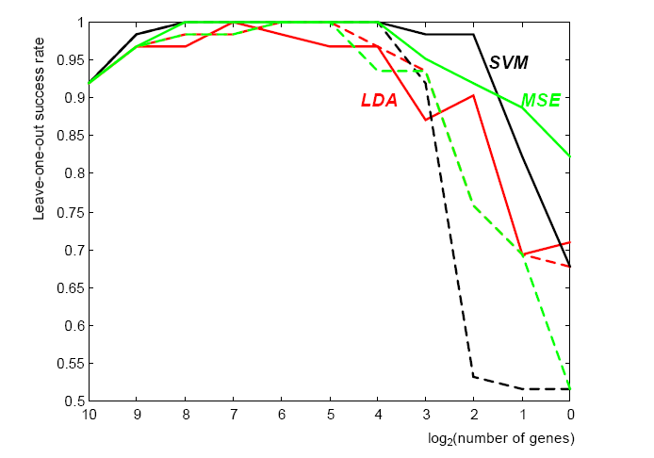
2. Gene selection
Recursive Feature Elimination (RFE)
22 normal 40 Colon cancer tissues
2000 genes after pre-processing
Leave-one-out cross validation
Dashed lines: filter method by naïve ranking
Solid lines: RFE (a wrapper method)
Guyon et al 2002

Slide 54
2. Gene selection
Embedded method:
Attempt to jointly or simultaneously train both a classifier and a feature subset.
Often optimize an objective function that jointly rewards accuracy of classification and penalizes use of more features.
Intuitively appealing
Examples: nearest shrunken centroids, CART and other tree-based algorithms.

Slide 55
2. Gene selection
Common practice to do feature selection using the whole data, then CV only for model building and classification.
However, usually features are unknown and the intended inference includes feature selection. Then, CV estimates as above tend to be downward biased.
Features (variables) should be selected only from the training set used to build the model (and not the entire set)

Slide 56
3. Performance assessment

Slide 57
3. Performance assessment

Slide 58
3. Performance assessment
Youden index=sensitivity+specificity-1

Slide 59
4. Case study
From UCSF Fridlyand J

Slide 60
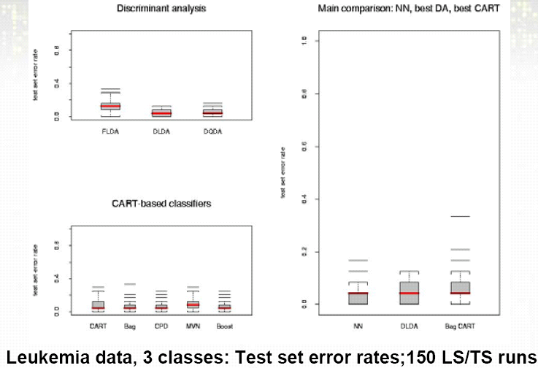
4. Case study
FLDA
DLDA
DQDA
KNN
DLDA
Bag CART

Slide 61
4. Case study

Slide 62
4. Case study

Slide 63
4. Case study

Slide 64
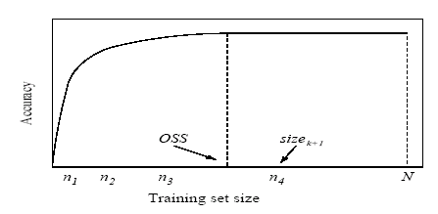
5. Sample size estimation
Intuitively the larger sample size, the better accuracy (smaller error rate).

Slide 65
5. Sample size estimation
Estimating Dataset Size Requirements for
Classifying DNA Microarray Data
SAYAN MUKHERJEE, PABLO TAMAYO,SIMON ROGERS, RYAN RIFKIN, ANNA ENGLE, COLIN CAMPBELL, TODD R. GOLUB, and JILL P. MESIROV.
JOURNAL OF COMPUTATIONAL BIOLOGY
Volume 10, Number 2, 2003 P119-142

Slide 66
5. Sample size estimation
Various theorems have suggested an inverse-power-law:
e(n): error rate when sample size=n.
b: Bayes error, the minimum error achievable.

Slide 67
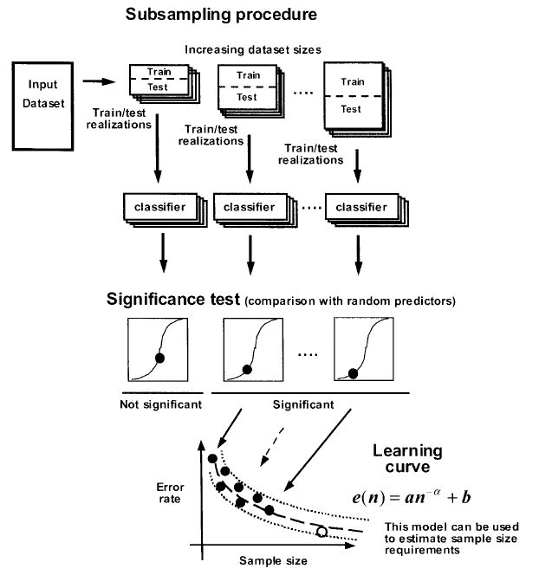
5. Sample size estimation
random
permutation
test

Slide 68
5. Sample size estimation

Slide 69
6. Common mistakes
Common mistakes:
Perform t-statistics to select a set of genes distinguishing two classes. Restrict on this set of genes and do cross validation using a selected classification method to evaluate the classification error.
The gene selection should not apply to the whole data if we want to evaluate the “true” classification error. The selection of genes already used information in testing data. The resulting error rate is down-ward biased.

Slide 70
6. Common mistakes
Common mistakes (cont’d):
Suppose a rare (1%) subclass of cancer is to be predicted. We take 50 rare cancer samples and 50 common cancer samples and find 0/50 errors in rare cancer and 10/50 for common cancer. => conclude 10% error rate!
The assessment of classification error rate should take population proportions into account. The overall error rate in this example is actually ~20%. In this case, it’s better to specify specificity and sensitivity separately.

Slide 71
7. Conclusion
Classification is probably the analysis most relevant to clinical application.
Performance is usually evaluated by cross validation and overfitting should be carefully avoided.
Gene selection should be carefully performed.
Interpretability and performance should be considered when choosing among different methods.
Resulting classification error rate should be carefully interpreted.

Slide 72
Classification methods available in R packages
Linear and quadratic discriminant analysis:
“lda” and “qda” in “MASS” package
DLDA and DQDA: “stat.diag.da” in “sma” package
KNN classification: “knn” in “class”package
CART: “rpart” package
Bagging: “Ipred” package
Random forest: “randomForest” package
Support Vector machines: “svm” in “e1071” package
Nearest shrunken centroids: “pamr” in “pamr” package

