Slide 1
Agenda
Bayes rule
Popular classification methods
Logistic regression
Linear discriminant analysis (LDA)/QDA and Fisher criteria
K-nearest neighbor (KNN)
Classification and regression tree (CART)
Bagging
Boosting
Random Forest
Support vector machines (SVM)
Artificial neural network (ANN)
Nearest shrunken centroids

Slide 2
1. Bayes rule
Bayes rule:
For known class conditional densities p_{k}(X)=f(X|Y=k), the Bayes rule predicts the class of an observation X by
C(X) = argmax_{k} p(Y=k|x)
Specifically if p_{k}(X)=f(X|Y=k)~N(μ_{k}, Σ_{k}),
C(x) = arg min_{k} {(x- μ_{k}) Σ_{k}⁻¹(x- μ_{k})′ + log|Σ_{k}| - 2 log π _{k} }

Slide 3
1. Bayes rule
Bayes rule is the optimal solution if the conditional probabilities can be well-estimated.
In reality, the conditional probabilities p_{k}(X) are difficulty to estimate if data in high-dimensional space
(curse of dimensionality).

Slide 4
2. Popular machine learning methods
Logistic regression
(our old friend from first applied statistics course; good in many medical diagnosis problems)
Linear discriminant analysis (LDA)/QDA and Fisher criteria
(best under simplified Gaussian assumption)
K-nearest neighbor (KNN)
(an intuitive heuristic method)
Classification and regression tree (CART)
(a popular tree method)
Bagging
(resampling method: bootstrap+model averaging)
Boosting
(resampling method: importance resampling; popular in 90s)
Random Forest
(resampling method: bootstrap+decorrelation+model averaging)
Support vector machines (SVM)
(a hot method from ~95’ to now)
Artificial neural network (ANN)
(a hot method in the 80-90s)
Nearest shrunken centroids
(shrinkage method for automatic gene selection)

Slide 5
2. Popular machine learning methods
There’re so many methods. Don’t get overwhelmed!!
It’s impossible to learn all these methods in one lecture. But you get an exposure of the research trend and what methods are available.
Each method has their own assumptions and model search space and thus with their strength and weakness (just like t-test compared to Wilcoxon test).
But some methods do find wider range of applications with consistent better performance (e.g. SVM, Bagging/Boosting/Random Forest, ANN).
Usually no universally best method. Performance is data dependent.
For microarray applications, JW Lee et al (2005; Computational Statistics & Data Analysis 48:869-885) provides a comprehensive comparative study.

Slide 6
2.1 Logistic regression
p_{i}: Pr(Y=1|X=x₁,…x_{k})
The same as simple regression, data should follow the underlying linear assumption to ensure good performance.

Slide 7
2.2 LDA
Linear Discriminant Analysis (LDA)
Suppose conditional probability in each group follows Gaussian distribution:
LDA: Σ_{k} = Σ ,
C(x) = arg min_{k} (μ_{k}Σ⁻¹μ_{k}′ - 2x Σ⁻¹μ_{k}′)
(we can prove the separation boundaries are linear boundaries)
Problem: too many parameters to estimate in Σ.

Slide 8
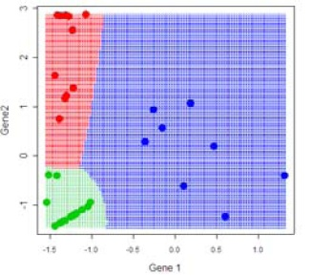
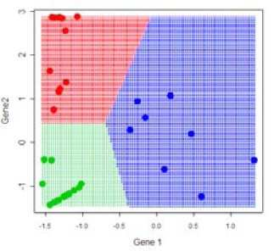
2.2 LDA
Two popular variations of LDA:
Diagonal Quadratic Discriminant Analysis(DQDA) and DLDA
(quadratic boundaries)
(linear boundaries)

Slide 9
2.3 KNN

Slide 10
2.3 KNN

Slide 11
2.4 CART

Slide 12
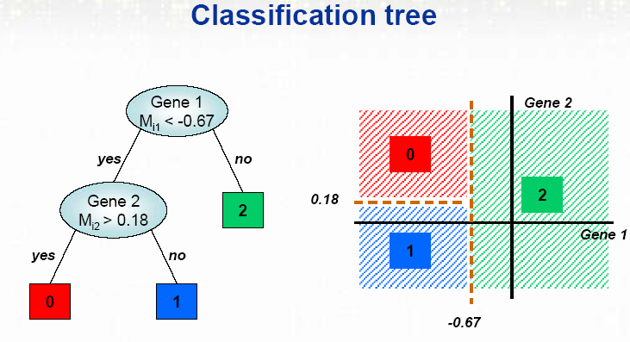
2.4 CART
Classification and Regression Tree (CART)
Splitting rule: impurity function to decide splits
Stopping rule: when to stop splitting/prunning
Bagging, Boosting, Random Forest?

Slide 13
2.4 CART
Splitting rule:
Choose the split that maximizes the decrease in impurity.
Impurity:
Gini Index
Entropy

Slide 14
2.4 CART
Split stopping rule:
A large tree is grown and procedures are implemented to prune the tree up-ward.
Class assignment:
Normally simply assign the majority class in the node unless a strong prior of the class probability is available.
Problem: Prediction model from CART is very unstable. Slight perturbation on data can produce very different CART tree and prediction. This calls for some modern resampling majority voting methods in 2.5-2.7.

Slide 15
2.5-2.7 Aggregating classifiers

Slide 16
2.5 Bagging
For each resampling, get a bootstrap sample.
Construct tree on each bootstrap sample as usual.
Perform 1-2 for 500 times. Aggregate the 500 trees by making majority votes to decide the prediction.

Slide 17
2.5 Bagging
Bootstrap samples

Slide 18
2.6 Boosting
Unlike Bagging, the resamplings are not independent in Boosting.
The idea is that if some cases are misclassified in previous resampling, they will have higher weight (probability) to be included in the new resampling. i.e. The new resampling will gradually become more focused on those difficult cases.
There’re many variations of Boosting proposed in the 90’s. “AdaBoost” is one of the most popular.

Slide 19
2.7 Random Forest
Random Forest is very similar to Bagging.
The only difference is that the construction of each tree in resampling is only restricted to a small percent of features (covariates) available.
It sounds a stupid idea but turns out very clever.
When sample size n is large, results in each resampling in Bagging are highly correlated and very similar. The power of majority vote to reduce the variance is weakened.
Restricting on different small proportions of features in each tree has some “de-correlation” effect.

Slide 20
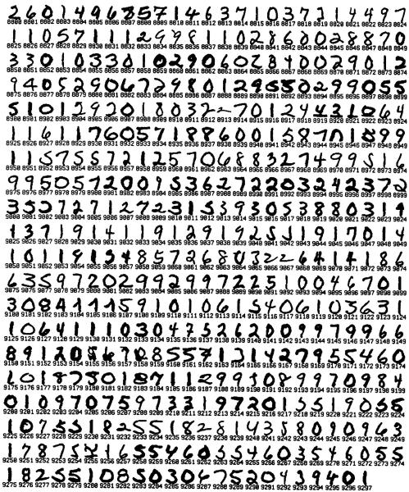
2.8 SVM
Famous Examples that helped SVM become popular

Slide 21
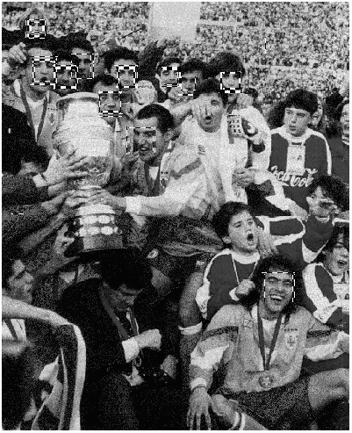
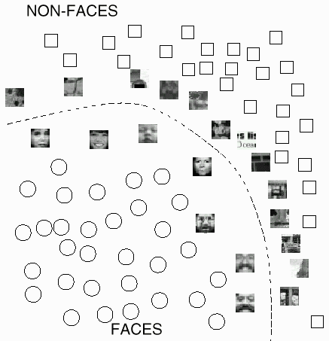
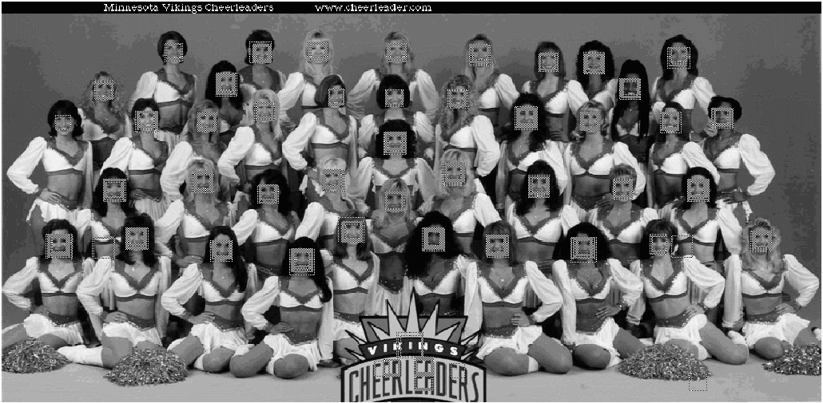

Slide 22
2.8 SVM
Support Vector Machines (SVM)
(Separable case)
Which is the best separation hyperplane?
The one with largest margin!!

Slide 23
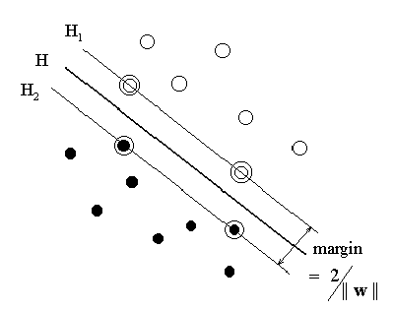
2.8 SVM
Support Vector Machines (SVM)
large margin provides better generalization ability
Maximizing Margin:
Correct Separation:

Slide 24
2.8 SVM
Using the Lagrangian technique, a dual optimization problem was derived:

Slide 25
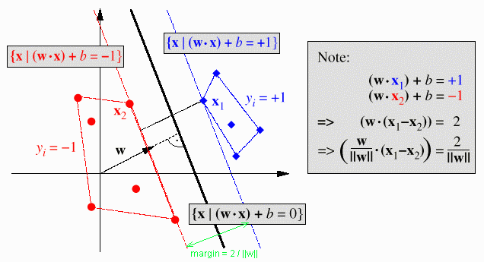
Why named “Support Vector Machine”?
2.8 SVM
Support Vectors

Slide 26
2.8 SVM

Slide 27
Nonseparable Case
2.8 SVM
Introduce slack variables , which turn into
Objective Function
(Soft Margin)
——Constant C controls the tradeoff between margin and errors.
Similar Dual Optimization Problem:

Slide 28
2.8 SVM
Support Vector Machines (SVM)
Non-separable case
Introduce slack variables , which turn into
Objective Function
(Soft Margin)
Extend to non-linear boundary
Kernel: K (satisfy some assumptions).
Find (w₁,…, w_{n}, b) to minimize
Idea: map to higher dimension so the boundary is linear in that space but non-linear in current space.

Slide 29
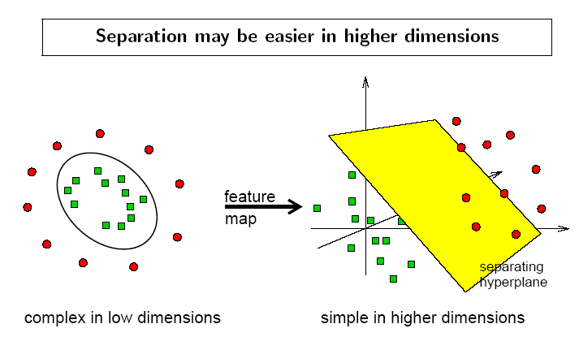
2.8 SVM
What about non-linear boundary?

Slide 30
2.8 SVM

Slide 31
2.8 SVM

Slide 32
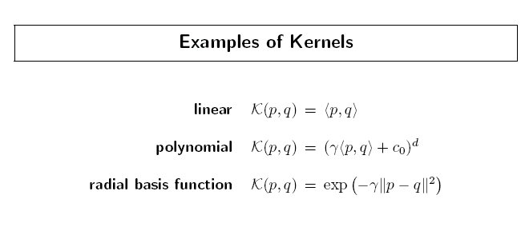
2.8 SVM

Slide 33
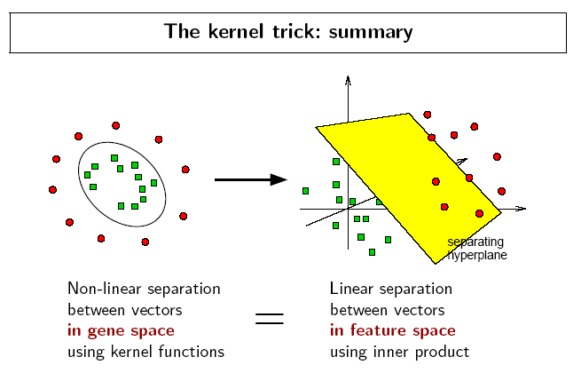
2.8 SVM

Slide 34
2.8 SVM

Slide 35
2.8 SVM
Comparison of LDA and SVM
LDA controls better for the tail distribution but has a more rigid distribution assumption.
SVM has more selection of the complexity of the feature space.

Slide 36
2.9 Artificial neural network
The idea comes from research in neural network in 80s.
The mechanism from inputs (expression of all genes) to output (the final prediction) goes through several layers of “hidden perceptrons”.
It’s a complex, non-linear statistical modelling.
Modelling is easy but computation is not that trivial.
gene 1
gene 2
final prediction
gene 3

Slide 37
2.10 Nearest shrunken centroid
Motivation: for gene i, class k, the measure
represents the discriminant power of gene i.
Tibshirani PNAS 2002

Slide 38
2.10 Nearest shrunken centroid
The original centroids:
The shruken centroids:
Use the shrunken centroids as the classifier.
The selection of shrunken parameter Δ will be determined later.

Slide 39
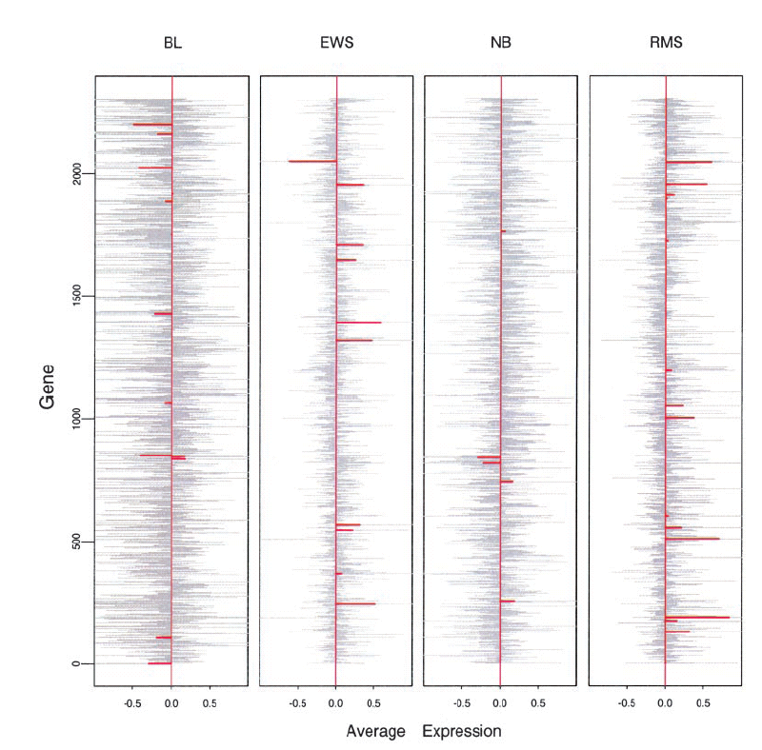
2.10 Nearest shrunken centroid

Slide 40
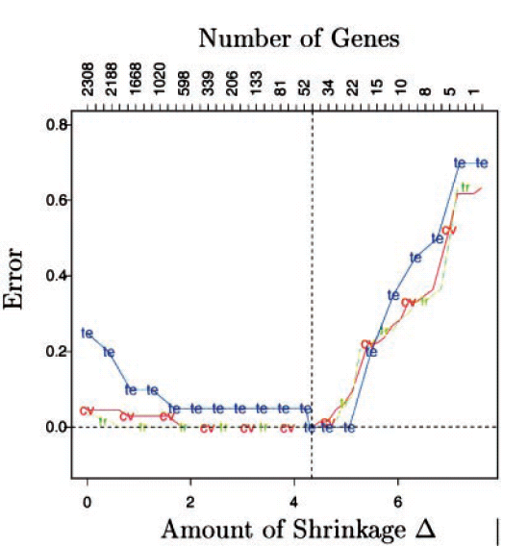
2.10 Nearest shrunken centroid

Slide 41
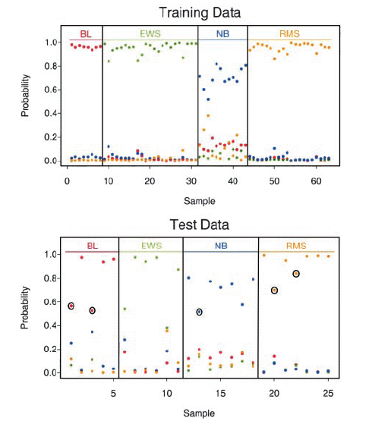
2.10 Nearest shrunken centroid

Slide 42
Considerations for supervised machine learning:
Prediction accuracy
Interpretability of the resulting model
Fitness of data to assumptions behind the method.
Computation time
Accessibility of software to implement

Slide 43
Classification methods available in Bioconductor
“MLInterfaces” package
This package is meant to be a unifying platform for all machine learning procedures (including classification and clustering methods). Useful but use of the package easily becomes a black box!!
Linear and quadratic discriminant analysis: “ldaB” and “qdaB”
KNN classification: “knnB”
CART: “rpartB”
Bagging and AdaBoosting: “baggingB” and “logitboostB”
Random forest: “randomForestB”
Support Vector machines: “svmB”
Artifical neural network: “nnetB”
Nearest shrunken centroids: “pamrB”

Slide 44
Classification methods available in R packages
Logistic regression:
“glm” with parameter “family=binomial().
Linear and quadratic discriminant analysis:
“lda” and “qda” in “MASS” package
DLDA and DQDA: “stat.diag.da” in “sma” package
KNN classification: “knn” in “class”package
CART: “rpart” package
Bagging and AdaBoosting: “adabag” package
Random forest: “randomForest” package
Support Vector machines: “svm” in “e1071” package
Nearest shrunken centroids: “pamr” in “pamr” package

