Slide 1
Agenda
Introduction to clustering
Dissimilarity measure
Preprocessing
Clustering method
Hierarchical clustering
K-means and K-memoids
Self-organizing maps (SOM)
Model-based clustering
Estimate # of clusters
Two new methods allowing scattered genes 4.1 Tight clustering
4.2 Penalized and weighted K-means
Cluster validation and evaluation
Comparison and discussion

Slide 2
Statistical Issues in Microarray Analysis
Experimental design
Image analysis
Preprocessing
(Normalization, filtering,
MV imputation)
Data visualization
Regulatory network
Identify differentially
expressed genes
Gene enrichment
analysis
Clustering
Classification
Integrative analysis &
meta-analysis

Slide 3
1. Introduction
“Clustering” is an exploratory tool for looking at associations within gene expression data
These methods allow us to hypothesize about relationships between genes and classes.
Cluster genes: similar expression pattern implies co-regulation.
Cluster samples: identify potential sub-classes of disease.

Slide 4
1. Introduction
Assigning objects to the groups
Estimating number of clusters
Assessing strength/confidence of cluster assignments for individual objects

Slide 5
1.1. Dissimilarity measure (correlation)
A metric is a measure of the similarity or dissimilarity between two data objects and it’s used to form data points into clusters
Two main classes of distance:
-- 1- Correlation coefficients (scale-invariant)
-- Distance metric (scale-dependent)

Slide 6
1.1. Dissimilarity measure (correlation)

Slide 7
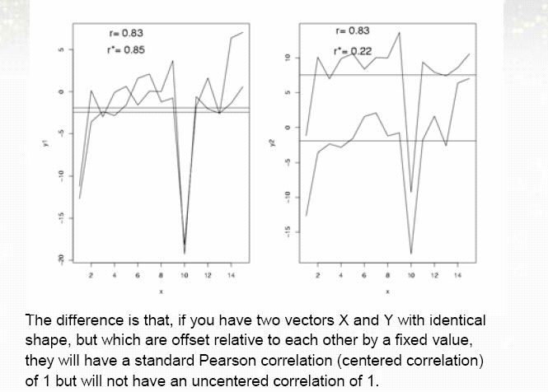
1.1. Dissimilarity measure (correlation)
Centered vs Uncentered correlation
(centered is preferred in microarray analysis)

Slide 8
1.1. Dissimilarity measure (correlation)
Positive and negative correlation
Biologically not
interesting

Slide 9
1.1. Dissimilarity measure (distance)

Slide 10
1.1. Dissimilarity measure
Euclidean
distance
Pearson
correlation

Slide 11
1.2. Preprocessing
A procedure normally used when clustering genes in microarray:
Filter genes with small coefficient of variation (CV). (CV=stdev/mean)
Standardize gene rows to mean 0 and stdev 1.
Use Euclidean distance.
Advantages:
Step 1. takes into account the fact that high abundance genes normally have larger variation. This filters “flat” genes.
Step 2. make Euclidean distance and correlation equivalent.
Many useful methods require the data to be in Euclidean space.

Slide 12
2. Clustering methods

Slide 13
2. Clustering methods
Hierarchical clustering
K-means; K-memoids/Partition around Memoids (PAM)
Self-Organizing maps
Model-based clustering
CLICK
FUZZY
Bayesian model-based clustering
Tight clustering
Penalized and weighted K-means

Slide 14
2.1. Hierarchical clustering

Slide 15
2.1. Hierarchical clustering
The most popular hierarchical clustering methods

Slide 16
2.1. Hierarchical clustering

Slide 17
2.1. Hierarchical clustering
Choice of linkage

Slide 18
2.1. Hierarchical clustering
Choice of linkage

Slide 19
2.1. Hierarchical clustering
Choice of linkage

Slide 20
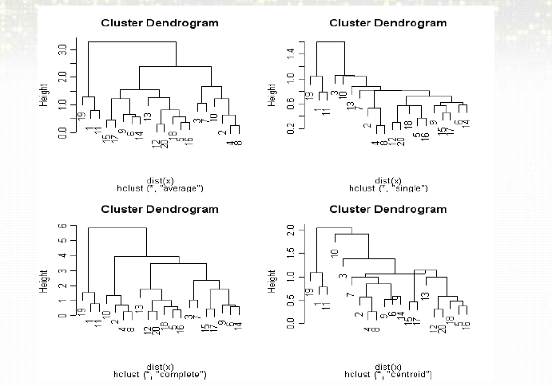
2.1. Hierarchical clustering
Choice of linkage

Slide 21
2.1. Hierarchical clustering
Tree presentation

Slide 22
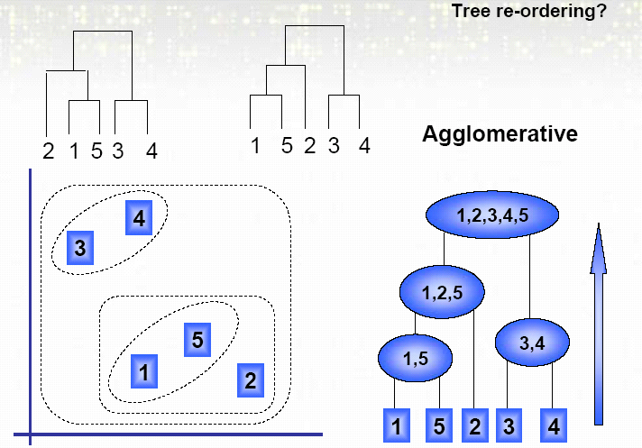
2.1. Hierarchical clustering
Tree presentation

Slide 23
2.1. Hierarchical clustering
Discussion:
The most overused statistical method in gene expression analysis
Gives us pretty red-green picture with patterns
But the pretty picture tends to be unstable.
Many different ways to perform hierarchical clustering
Tend to be sensitive to small changes in the data
Provided with clusters of every size: where to “cut” the dendrogram is user-determined.

Slide 24
2.2.~2.4. Partitioning methods

Slide 25
2.2. K-means

Slide 26
2.2. K-means
Algorithm:
Minimize the within-cluster dispersion to the cluster centers.
Note:
1. Points should be in Euclidean space.
2. Optimization performed by iterative relocation algorithms. Local minimum inevitable.
3. k has to be correctly estimated.

Slide 27
2.2. K-means
Choose K centroids at random.
Make initial partition of objects into k clusters by assigning objects to closest centroid.
M-step: Calculate the centroid (mean) of each of the k clusters.
E-step: Reassign objects to the closest centroids.
Repeat 3 and 4 until no reallocations occur.

Slide 28
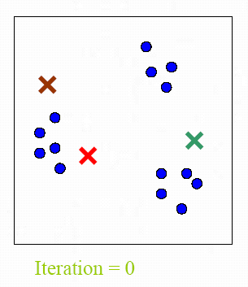
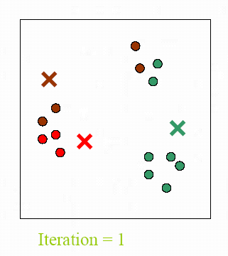
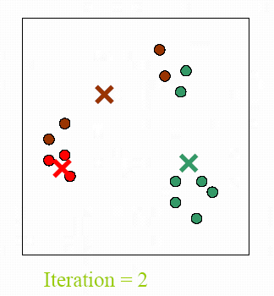
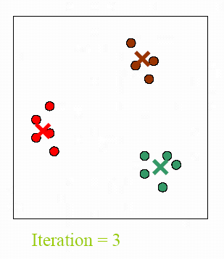
2.2. K-means
EM algorithm: The object assignment (into clusters) is viewed as missing.

Slide 29
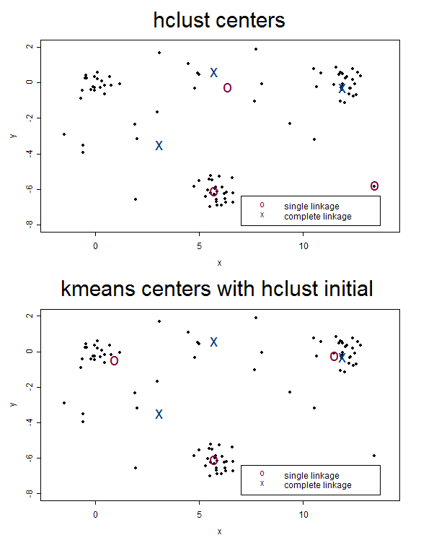
2.2. K-means
Local minimum problem:
Initial values
for K-means.
“x” falls into local minimum.

Slide 30
2.2. K-means
Advantage:
Fast: o(KN) instead of o(N²) in hierarchical clustering.
Relationship to Gaussian mixture model.
Disadvantage:
Local minimum problem very common
Does not allow scattered genes
Estimation of # of clusters has to be accurate

Slide 31
2.2. K-means
Very useful when objects not in Euclidean space!

Slide 32
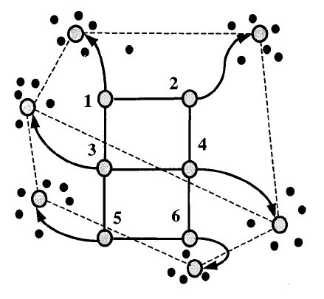
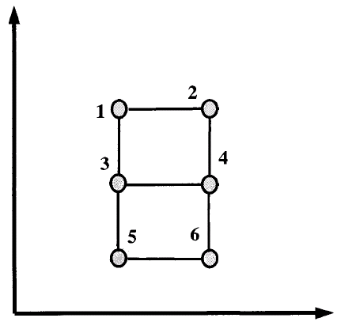
2.3. SOM
R²
R^{p}

Slide 33
2.3. SOM
Six nodes (N₁, N₂,…, N₆) of 3 × 2 grids on 2D are first selected. Denote d(N_{i},N_{j}) the distance of two nodes on 2D space.
Set a random initial map f₀: (N₁, N₂,…, N₆) → R^{p} (the gene expression space).
At each iteration, a data point (gene) P is randomly selected. N_{P} is the node that maps nearest to P. Then the mapping of nodes is updated by moving points towards P:
The learning rate decreases with distance of nod N from N_{P} and with iteration number i.
Data point P is selected from a random order of genes and recycled. The procedures continue for 20,000-50,000 iterations.

Slide 34
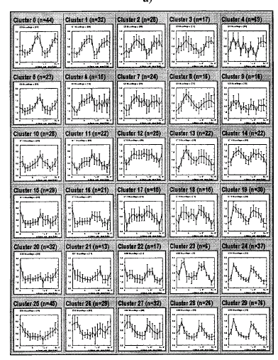
2.3. SOM
Yeast cell cycle data. 828 genes. 6 × 5 SOM.
Average patterns and error bars are shown for each cluster.

Slide 35
2.3. SOM
Advantages:
Better visualization and interpretation. Nodes closer in 2D space will have corresponding clusters also closer.
Easier to re-group similar clusters
Disadvantages:
SOM can be viewed as a restricted form of K-means. (K-means restricted on 2D geometry).
The result is suboptimal in some sense.
A heuristic algorithm.

Slide 36
2.4. Model-based clustering

Slide 37
2.4. Model-based clustering
-- Classification likelihood:
-- Mixture likelihood:
Gaussian assumption:

Slide 38
2.4. Model-based clustering
Model-based approach:
Fraley and Raftery (1998) applied a Gaussian mixture model.

Slide 39
2.4. Model-based clustering
EM algorithm to maximize the mixture likelihood.
Model selection: Bayesian Information Criterion (BIC) for determining k and the complexity of the covariance matrix.

Slide 40
2.4. Model-based clustering
Mixture model with noise or outliers:

Slide 41
2.4. Model-based clustering
Advantages:
Flexibility on cluster covariance structure.
Rigorous statistical inference with full model.
Disadvantages:
Model selection is usually difficult. Data may not fit Gaussian model.
Too many parameters to estimate in complex covariance structure.
Local minimum problem

Slide 42
3. Estimate # of clusters
Milligan & Cooper(1985) compared over 30 published rules. None is particularly better than all the others. The best method is data dependent.
1. Calinski & Harabasz (1974)
Where B(k) and W(k) are the between-and within-cluster sum of sqaures with k clusters.
2. Hartigan (1975)
, Stop when H(k)<10

Slide 43
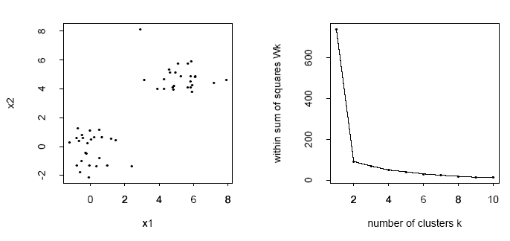
3. Estimate # of clusters
3. Gap statistic: Tibshirani, Walther & Hastie (2000)
Within sum of squares W(k) is a decreasing function of k.
Normally look for a turning point of elbow-shape to identify the number of clusters, k.

Slide 44
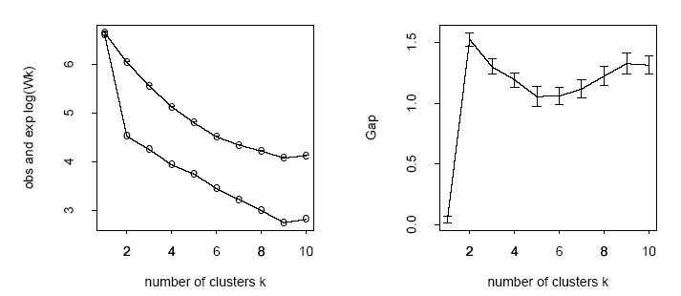
3. Estimate # of clusters
Instead of the above arbitrary criterion, the paper proposes to maximize the following Gap statistics. The background expectation is calculated from random sampling from .

Slide 45
The background expectation is calculated from random sampling from uniform distribution.
Observations
Bounding Box (aligned with feature axes)
Monte Carlo Simulations
Observations
Bounding Box (aligned with principle axes)
Monte Carlo Simulations

Slide 46
Computation of the Gap Statistic
for l = 1 to B
Compute Monte Carlo sample X_{1b}, X_{2b}, …, X_{nb} (n is # obs.)
for k = 1 to K
Cluster the observations into k groups and compute log W_{k}
for l = 1 to B
Cluster the M.C. sample into k groups and compute log W_{kb}
Compute
Compute sd(k), the s.d. of {log W_{kb}}_{l=1,…,B}
Set the total s.e.
Find the smallest k such that

Slide 47
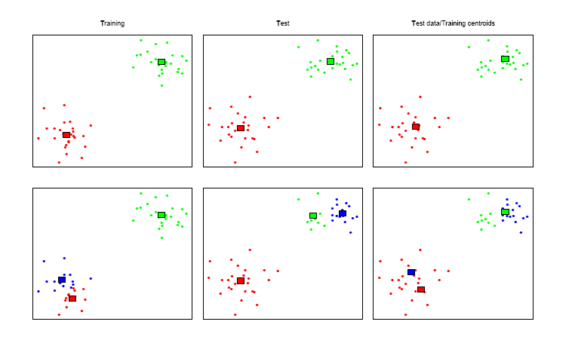
3. Estimate # of clusters
4. Resampling methods:
Tibshirani et al. (2001); Dudoit and Fridlyand (2002)
Treat as underlying truth.
Compare

Slide 48
3. Estimate # of clusters
: training data
: testing data
: K-means clustering cetroids from training data
: comembership matrix
Prediction strenth:
A_{k1}, A_{k2},…, A_{kk} be the K-means clusters from test data X_{te}
n_{kj}=#(A_{kj})
Find k that maximizes ps(k).

Slide 49
3. Estimate # of clusters
Conclusions:
There’s no dominating “good” method for estimating the number of clusters. Some are good only in some specific simulations or examples.
Imagine in a high-dimensional complex data set. There might not be a clear “true” number of clusters.
The problem is also about the “resolution”. In “coarser” resolution few loose clusters may be identified, while in “refined” resolution many small tight clusters will stand out.

