Slide 1
Genomic meta-analysis in combining expression profiles

Slide 2
Outline
Introduction
Two review papers
Quality control (MetaQC)
Meta-analysis for detecting differentially expressed genes (MetaDE)
Meta-analysis for detecting pathways (MetaPath)

Slide 3
1. Introduction

Slide 4
Statistical Issues in Microarray Analysis
Experimental design
Image analysis
Preprocessing
(Normalization, filtering,
MV imputation)
Data visualization
Regulatory network
Identify differentially
expressed genes
Gene enrichment
analysis
Clustering
Classification
Integrative analysis &
meta-analysis

Slide 5
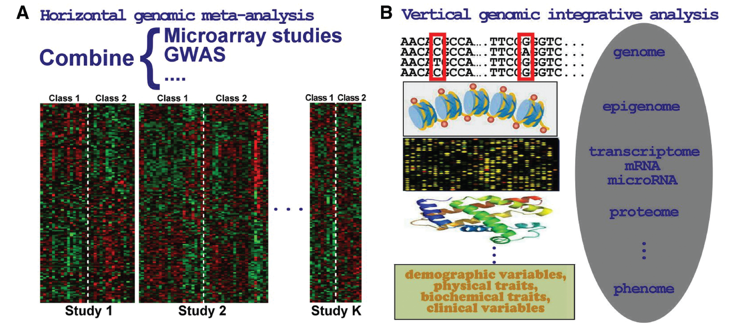
Meta-analysis and integrative analysis

Slide 6
Meta-analysis and integrative analysis
Horizontal genomic meta-analysis: Combine multiple relevant studies (e.g. microarray or GWAS) to increase statistical power.
Vertical genomic integrative analysis: Integrate multiple studies that measure multiple dimension of genetic information of the same cohort (e.g. transcription, genotyping, copy number variation, methylation, miRNA etc).

Slide 7
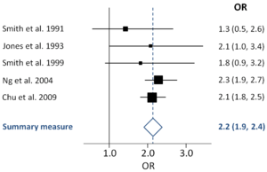
Genomic meta-analysis
In this lecture, we’ll more focus on microarray meta-analysis but the principles applies to GWAS as well.
In statistics, a “meta-analysis” combines the results of several studies that address a set of related research hypotheses.
In the literature, many microarray meta-analysis have been done. Advantages include:
Increase statistical power
Provide robust and accurate
validation across studies
The result can guide future experiments.
Many methods in microarray meta-analysis can be extended for genomic integrative analysis.

Slide 8
Motivation
Microarray has become a common tool in biological investigation. Related high-throughput technologies (SNP array, ChIP-chip, next-generation sequencing) are also getting popular.
As many data sets are publicly available, information integration of multiple studies becomes important.

Slide 9
Microarray databases
Primary database
Gene Expression Omnibus (GEO) in NCBI
ArrayExpress in EBI
Stanford Microarray database
caArray at NCI
Secondary database
GEO Profiles (extension from GEO)
Gene Expression Atlas (extension from ArrayExpress)
Genevestigator database
Oncomine

Slide 10
Motivation and background
Data considered:
study 1
genes | N | … | N | T | … | T | statistic
1 |  |  |  |  |  |  | t₁₁
2 |  |  |  |  |  |  | t₂₁
3 |  |  |  |  |  |  | t₃₁
… |  |  |  |  |  |  | …
G |  |  |  |  |  |  | t_{G1}
study 2
genes | N | … | N | T | … | T | statistic
1 |  |  |  |  |  |  | t₁₂
2 |  |  |  |  |  |  | t₂₂
3 |  |  |  |  |  |  | t₃₂
… |  |  |  |  |  |  | …
G |  |  |  |  |  |  | t_{G2}
study K
genes | N | … | N | T | … | T | statistic
1 |  |  |  |  |  |  | t_{1K}
2 |  |  |  |  |  |  | t_{K}
3 |  |  |  |  |  |  | t_{3K}
… |  |  |  |  |  |  | …
G |  |  |  |  |  |  | t_{GK}

Slide 11
1. Motivation and background
Assume
K homogeneous studies are considered for information integration. (inclusion/exclusion criteria)
Genes are matched across all studies with no missing value. (gene matching across studies)
For each study, samples of two groups ( eg. normal vs tumor) are available.
Q: how meta-analysis can help to enhance biomarker detection?

Slide 12
Steps for genomic meta-analysis
Identify biological objectives
Data sets available; inclusion/exclusion criteria
Biological questions to be answered
(Biomarker detection in two groups of samples)
Set up of statistical framework
Choice of methods

Slide 13
2. Two review papers

Slide 14
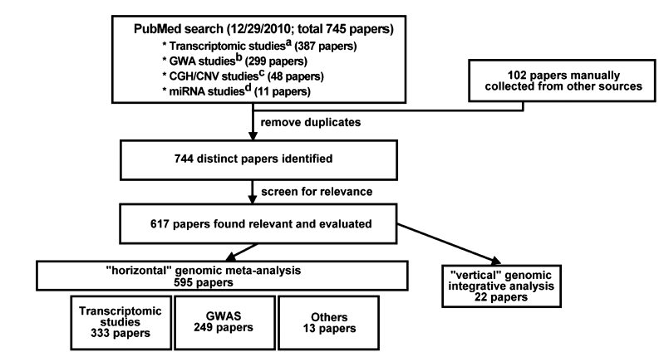
Two review papers
George C. Tseng*, Debashis Ghosh and Eleanor Feingold. (2012) Comprehensive literature review and statistical considerations for microarray meta-analysis. Nucleic Acids Research. accepted.
Ferdouse Begum, Debashis Ghosh, George C. Tseng*, Eleanor Feingold. (2012) Comprehensive literature review and statistical considerations for GWAS meta-analysis. Nucleic Acids Research. accepted.

Slide 15
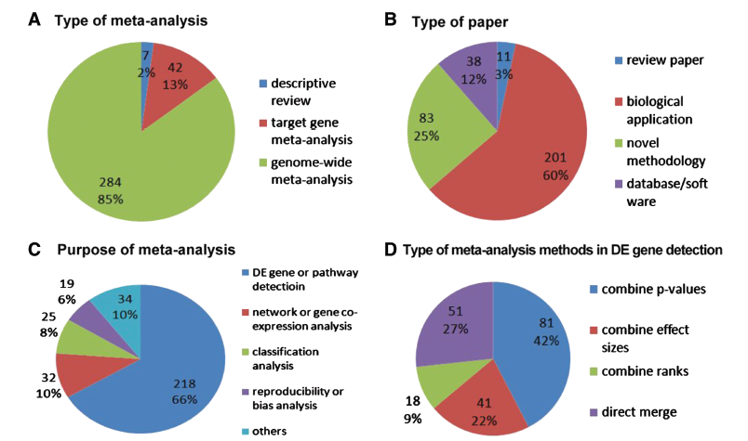
Summary of microarray meta-analysis

Slide 16
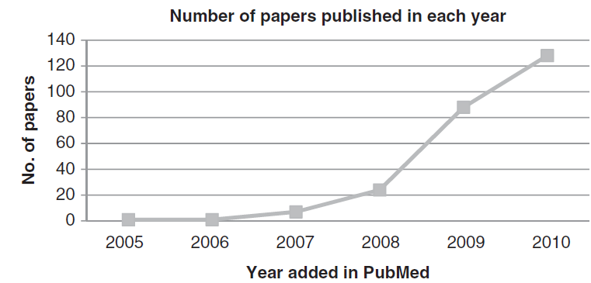
Summary of GWAS meta-analysis

Slide 17
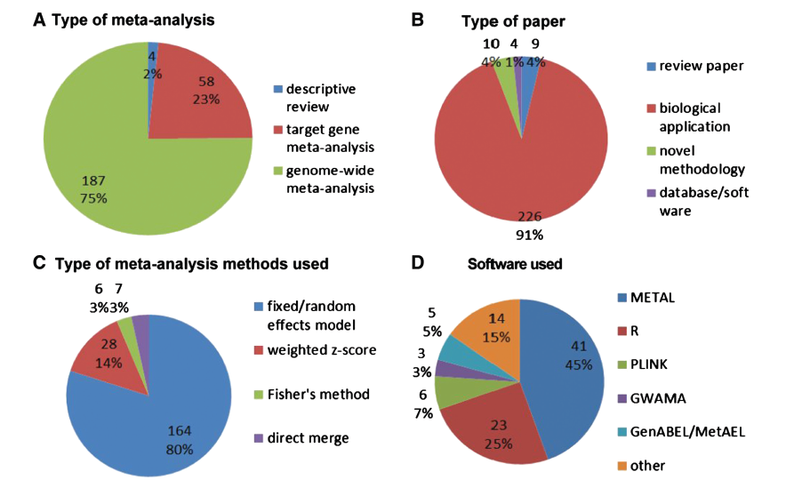
Summary of GWAS meta-analysis

Slide 18
3. Quality control (MetaQC)

Slide 19
MetaQC
Quality control analysis to determine inclusion/exclusion criteria for microarray meta-analysis
Dongwan D. Kang, Etienne Sibille, Naftali Kaminski, and George C. Tseng*. (2012) MetaQC: Objective Quality Control and Inclusion/Exclusion Criteria for Genomic Meta-Analysis. Nucleic Acids Research. 40(2):e15.

Slide 20
Inclusion/exclusion criteria
Examples of inclusion/exclusion criteria in the literature:
Collect whatever microarray data sets available to combine
Go to GEO to retrieve all relevant studies in Affymetrix U133
At least four samples in each class label
…
Problem: ad hoc criteria and “expert” opinion
Aim: Is it possible to develop a quantitative quality assessment to perform inclusion/exclusion of the microarray studies?

Slide 21
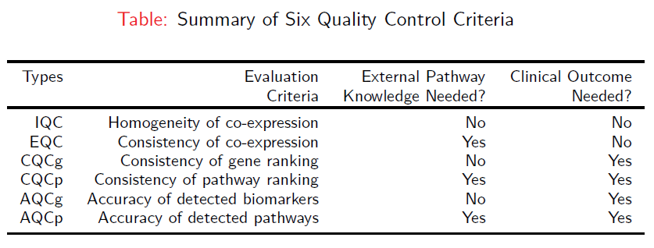
Six quality control (QC) measures
Each QC measure is defined as minus log-transformed p-values from formal hypothesis testing.

Slide 22
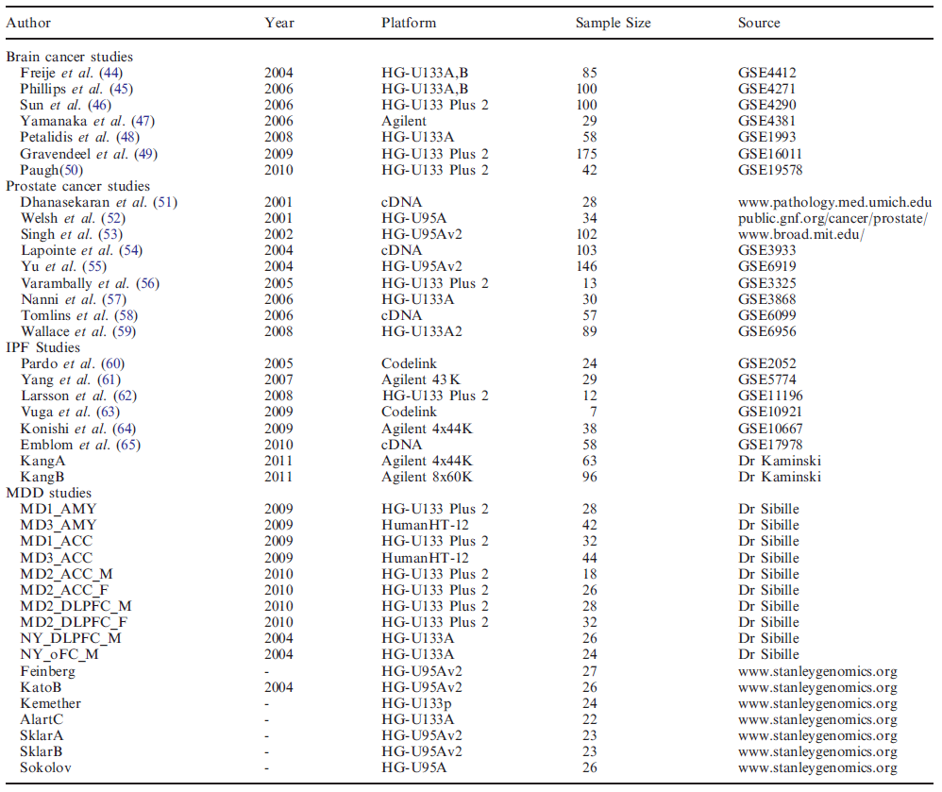
Four example tested

Slide 23
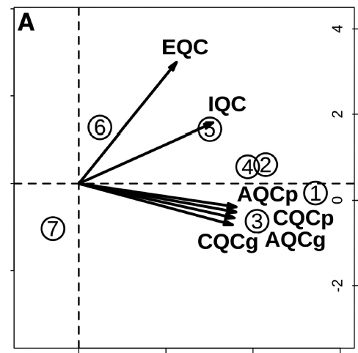
Brain cancer example
Paugh and Yamanaka have lower quality and will be excluded from meta-analysis.
These two studies have small sample sizes.

Slide 24
4. Meta-analysis for detecting differentially expressed genes (MetaDE)

Slide 25
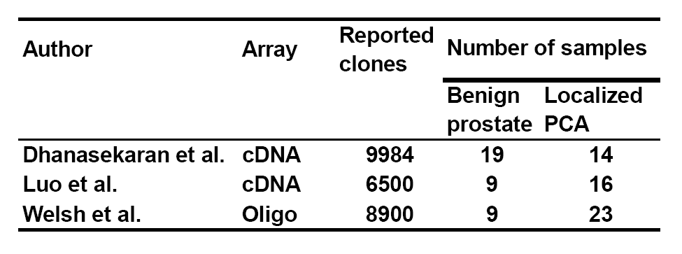
example
prostate cancer data
Each study contains small number of samples. Makes sense to perform meta-analysis.

Slide 26
Key issues in microarray meta-analysis
(Ramasamy et al., PLoS Medicine 2008)
(1) Identify suitable microarray studies;
(2) Extract the data from studies;
(3) Prepare the individual datasets;
(4) Annotate the individual datasets;
(5) Resolve the many-to-many relationship between probes and genes;
(6) Combine the study-specific estimates;
(7) Analyze, present, and interpret results.

Slide 27
Goal of meta-analysis
Goal of meta-analysis:
What kind of biomarkers is of interest:
Biomarkers statistically significant and consistent in all (or majority) of the studies.
Biomarkers statistically significant in one or more studies.

Slide 28
Two hypothesis setting
 | Study 1 | Study 2 | Study 3 | Study 4 | Study 5
gene A | 0.1 | 0.1 | 0.1 | 0.1 | 0.1
gene B | 1E-5 | 1 | 1 | 1 | 1
Detect genes consistently DE in all studies
(similar to union-intersection test; IUT)
Detect genes DE in at least one of the K studies
(intersection-union test; UIT)

Slide 29
Two popular methods
Example: p-values of four studies=(0.5, 0.06, 0.07, 0.1)
Fisher’s method
maxP

Slide 30
Two hypothesis setting
 | Study 1 | Study 2 | Study 3 | Study 4 | Study 5
gene A | 0.1 | 0.1 | 0.1 | 0.1 | 0.1
gene B | 1E-5 | 1 | 1 | 1 | 1
HS_{A} type of DE genes are usually more desirable and can quickly narrow down gene targets.
But genomic studies combined are usually not as consistent as hoped. HS_{A} type of analysis can only detect small number of genes.
Heterogeneity between studies can exist by nature (e.g. Five different tissues are studied in each study).

Slide 31
Meta-analysis
Four category of microarray meta-analysis methods:
Combine p-values
Fisher, Stouffer, minP, maxP, adaptively weighted (AW) Fisher, rth ordered p-value (rOP), vote counting
Combine effect sizes
Random effects model, fixed effects model, Bayesian methods
Combine ranks
Rank sum, rank product, rank aggregation
Direct merging
Directly merge studies for analysis, various normalization methods (DWD, XPN …)

Slide 32
Illustrative examples
Meta-dE
 | Study 1 | Study 2 | Study 3 | Study 4 | Study 5 |  | Fisher (old) | AW (new) | maxP (old) | rOP (new)
gene A | 0.1 | 0.1 | 0.1 | 0.1 | 0.1
gene B | 1E-5 | 1 | 1 | 1 | 1
gene C | 0.01 | 0.01 | 0.01 | 0.01 | 1
gene D | 0.2 | 0.2 | 0.2 | 0.2 | 0.2
DE in all studies
DE only in one study
DE in most studies
DE in all studies
0.01
0.01
6E-5
0.1
0.075 (1,1,1,1,1)
1E-4 (1,0,0,0,0)
1E-4 (1,1,1,1,0)
0.4 (1,1,1,1,1)
1E-5
1
1
3E-4
5E-4
1
5E-8
7E-3
Fisher: Detects gene A-C. Cannot distinguish between gene A & B.
AW (adaptively weighted): Detects gene A-C. Gives indicator of which studies are DE .
maxP: Detects gene A and D. but miss gene C.
rOP (r^{th} ordered p-value): Detects gene A, C and D. Provides more robustness.

Slide 33
Other methods
minP:
Adaptively weighted Fisher (Li & Tseng 2011)

Slide 34
Adaptively-weighted (AW) statistic
Basic idea of adaptively-weighted method
pvalues | Study I | Study II | Study III
Gene 1 | 0.10 | 0.10 | 0.10
Gene 2 | 1 | 1 | 0.001
Gene 2
weights | Weighted statistics | Null | pvlaue
(1,1,1) | 13.82 |  | 0.032
(1,1,0) | 0 |  | 1
(1,0,1) | 13.82 |  | 0.008
(1,0,0) | 0 |  | 1
(0,1,1) | 13.82 |  | 0.008
(0,1,0) | 0 |  | 1
(0,0,1) | 13.82 |  | 0.001
=> T=0.001
What weight combination gives the best statistical significance?
Given the best-weight, what is the null distribution and how to estimat FDR?

Slide 35
adaptively-weighted statistic
Method: What weight combination gives the best statistical significance?
Rationale:
In a traditional epidemiological study or a medical study, best-weight is severely biased to the signal we try to prove (a bad approach).
But in detecting DE genes in microarray study, it makes great biological sense. Some pathways may be altered only in some of the studies due to heterogeneous sample collection and experimental operations in different studies. It becomes very useful when combining many data sets.

Slide 36
adaptively-weighted statistic
From now on, we refer to Fisher’s method as equal-weight method (EW):
Our proposed adaptively-weighted method is:
In both cases, we avoid parametric assumption. Instead, we pursue “permutation test” to control FDR.

Slide 37
adaptively-weighted statistic
I. Evaluate study-specific p-values by permutation:

Slide 38
adaptively-weighted statistic
II. Calculate AW statistic:

Slide 39
adaptively-weighted statistic
Note: The searching space of w needs to specify. In the following we only search w_{k}={0,1}.
For example, if the pvalues of four studies are (0.03, 0.05, 0.51, 0.45), the above algorithm will select w=(1,1,0,0).

Slide 40
adaptively-weighted statistic
III. Assess q-values of AW statistic:

Slide 41
adaptively-weighted statistic
Advantage of our proposed method:
Inference is done through permutation analysis. No parametric assumption.
Instead of equal weight in Fisher’s method, our method pursues best weight of study contributions based on data.
The AW weights provides natural categorization of biomarkers for further biological investigation.

Slide 42
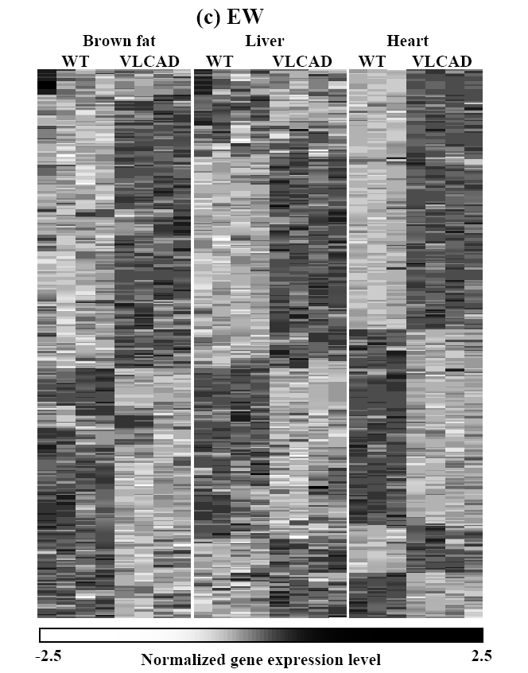
Fisher vs AW
Fisher’s method
Biomarkers detected by Fisher’s method (EW) and ordered by hierarchical clustering.
Genes are DE in one or more studies but no indication of which ones.

Slide 43
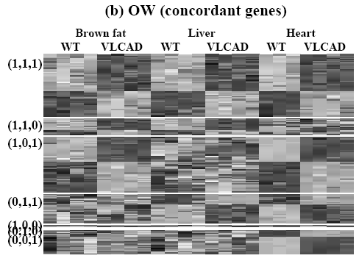
Fisher vs AW
Adaptively weighted (AW)
Biomarkers detected by AW method and ordered by hierarchical clustering.
The optimal weights provide natural categorization and interpretation of biomarkers.

Slide 44
Vote counting method
Compute statistical significance of differential expression (p-value) in each study.
For each gene, count the number of studies that have p-value smaller than a pre-defined threshold (e.g. 0.05).
Genes with vote count more than a pre-defined threshold (e.g. 5 out of 10 total studies) are considered as significant biomarkers.

Slide 45
Drawback of vote counting method
It is possible to assess statistical significance of vote counting method by permutation test.
This method is widely used in biological literature due to its simplicity.
But vote counting has been criticized in conventional meta-analysis and is an unfavorable approach.
A gene with weak signal in all studies is interesting but won’t be detected by vote counting
e.g. p-values= (0.1, 0.15, 0.07, 0.12).

Slide 47
REM vs FEM

Slide 48
Forest plot

Slide 49
Summary
Theoretically, meta-analysis provides improved statistical power by combining multiple studies with small sample size.
Different studies are performed by different platforms/protocol in different labs. Different patient cohorts are used.
Be aware of assumptions behind different methods and the final biological goal.

Slide 50
5. Meta-analysis for detecting pathways (MetaPath)
Kui Shen and George C Tseng*. (2010) Meta-analysis for pathway enrichment analysis when combining multiple microarray studies. Bioinformatics. 26:1316-1323.

Slide 51
Diagram for enrichment analysis

Slide 52
MAPE_G

Slide 53
Procedures of MAPE_G
I. For a given study k, compute p-values of differential expression:
. Compute the t-statistic, t_{gk}, of gene g in study k, where 1 ≤ g ≤ G, 1 ≤ k ≤ K.
. Permute group labels in each study B times, and calculate the permuted statistics, , where 1 ≤ b ≤ B.
. Estimate the p-value of t_{gk} as
and p-value of as
II. Meta-analysis:
. The maximum p-value statistic (maxP) , , is applied for the meta analysis. Similarly, .
. Estimate the p-value of maxP statistics as .
III. Enrichment analysis:
. Given a pathway p, compute v_{p}, the KS statistic for gene set enrichment based on p(u_{g}).
. Permute gene labels B times, and calculate the permuted statistics, , 1 ≤b≤B.
. Estimate p-value of pathway p as
and similarly calculate .
. Estimate q-value of pathway p as ,

Slide 54
MAPE_P

Slide 55
Procedures of MAPE_P
I. Pathway enrichment analysis:
. For each study k, Calculate , the p-value of gene g, by Student t-test, 1≤g≤G.
. Given a pathway p, compute the KS statistic v_{pk} that compares the p-values (p(t_{gk})) inside and outside the pathway.
. Permute gene labels B times, and calculate the permuted statistics, , 1 ≤ b ≤ B.
. Estimate the p-value of KS statistic in pathway p and study k as
and similarly calculate .
II. Meta-analysis:
. The maximum p-value statistic (maxP) is applied for meta-analysis:
and .
. Estimate p-value of w_{p} as .
Similarly .
. Estimate q-value as

Slide 56
Why two procedures?
Complementary advantages of MAPE_G vs MAPE_P
An example: AANU and HCTU gene sets

Slide 57
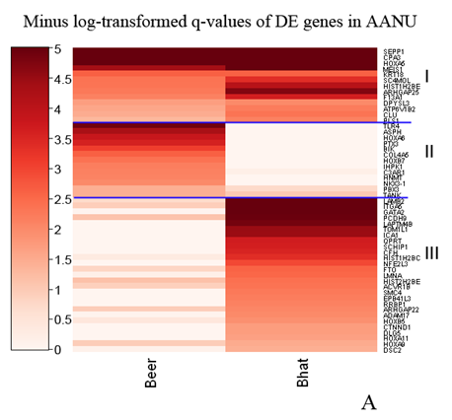
Why two procedures?

Slide 58
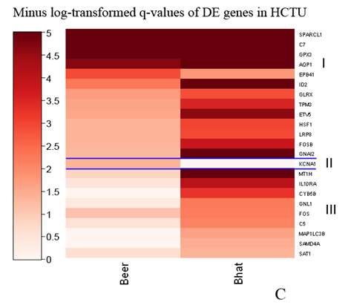
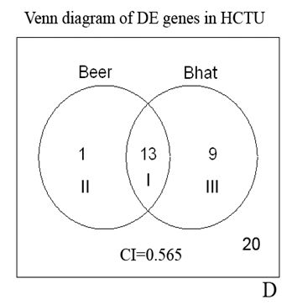
Why two procedures?

Slide 59
MAPE results

Slide 60
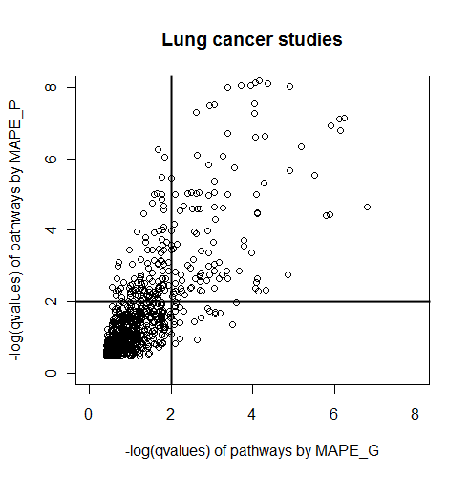
Combine MAPE_G and MAPE_P
MAPE_G and MAPE_P have complementary strengths. We are interested in pathways identified by both methods.

Slide 61
The procedure of MAPE_I

Slide 62
Procedures of MAPE_I
. Let and
from Procedures in MAPE_G and MAPE_P.
. Estimate the p-value as .
. Estimate q-value as .
are enriched pathways identified by MAPE_I.

Slide 63
Scenario 1 (different degrees of effect sizes)
MAPE_G has better power in large λ or small α.

Slide 64
Scenario 1 (different degrees of effect sizes)
Red line: power of MAPE_I
Blue line: power of MAPE_P
Green line: power of MAPE_G

Slide 65
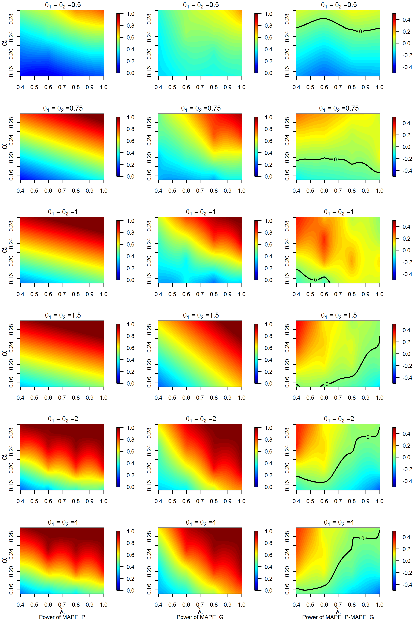
θ=0.5
Scenario 1 (different degrees of effect sizes)
1. When θ is low (0.5≤θ₁ = θ₂≤1), MAPE_G is more powerful than MAPE_P particularly when the pathway enrichment strength α is not high.
2. When θ is large (1.5≤θ₁ = θ₂≤4), MAPE_G is more powerful than MAPE_P when the array coverage rate λ (0.7≤λ≤1) is high and the pathway enrichment strength α is low (0.15≤λ≤0.2).
3. It shows complementary advantages of MAPE_G vs. MAPE_P.
θ=0.75
θ=1
θ=1.5
θ=2
θ=4

Slide 66
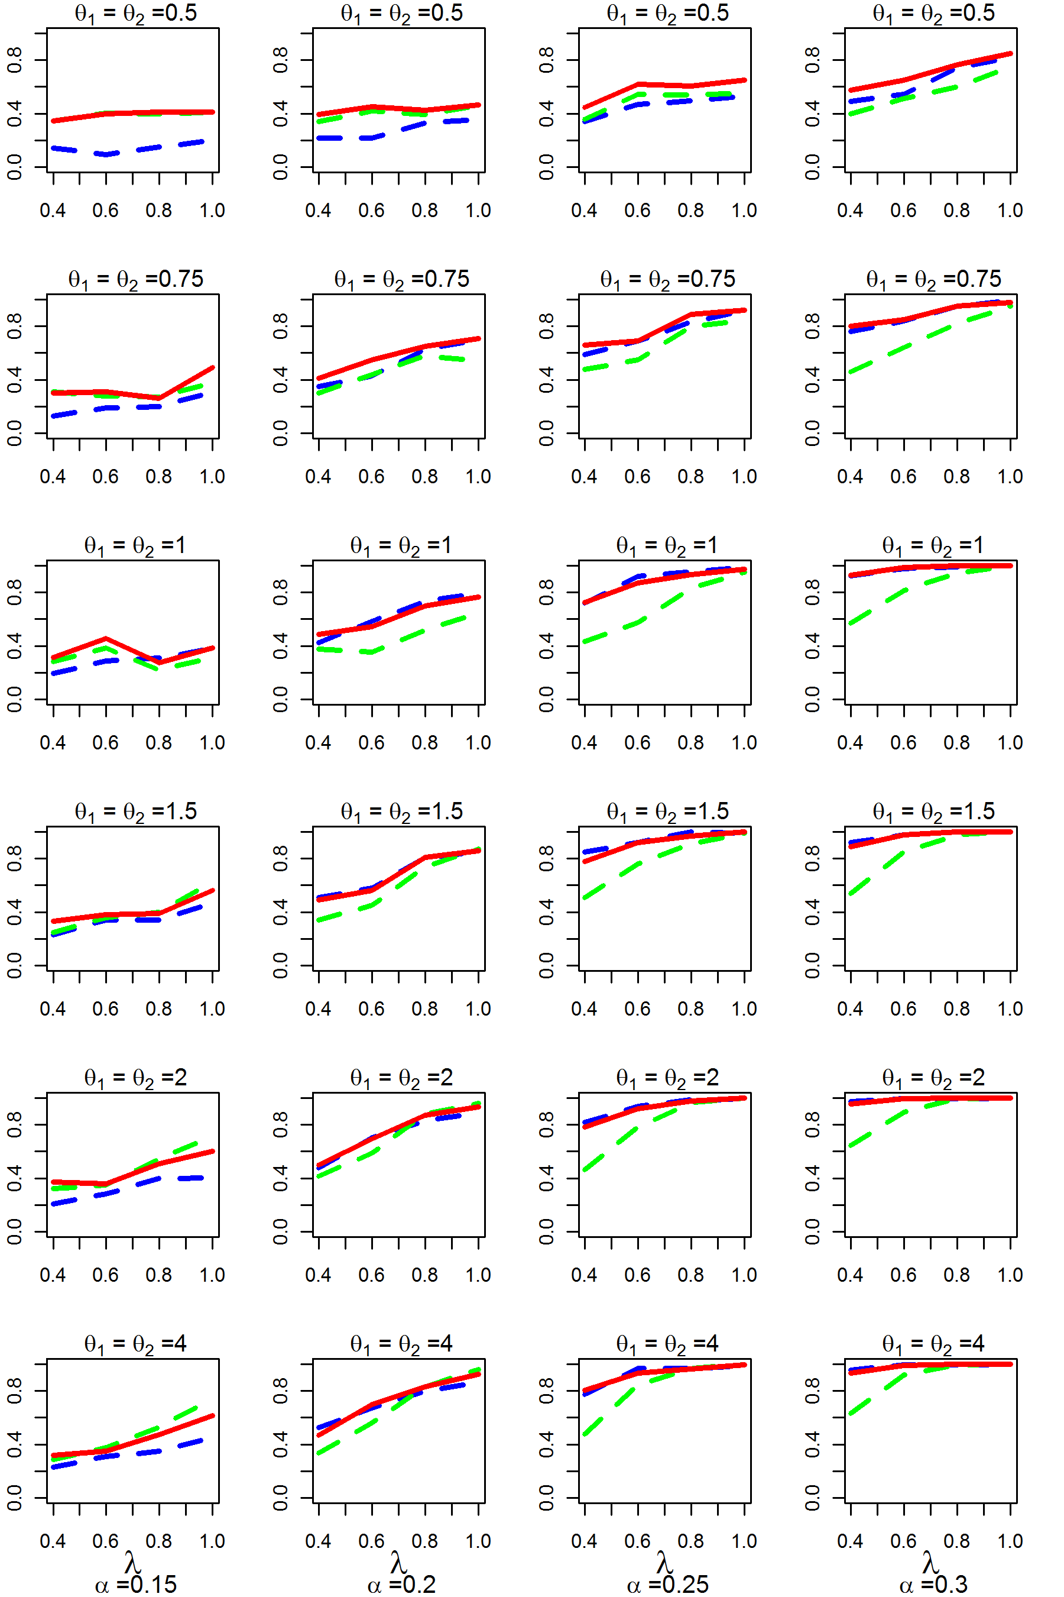
θ=0.5
Scenario 1 (different degrees of effect sizes)
MAPE_I (red) always has near the best statistical power among MAPE_G and MAPE_P, thus a good hybrid method to integrate complementary advantages of the two.
θ=0.75
θ=1
θ=1.5
θ=2
θ=4

Slide 67
Summary
MAPE_P and MAPE_G have complementary advantages depending on data structure.
The hybrid form MAPE_I integrates advantages of both approaches is usually recommended.
Our “MetaPath” package in R provides convenient routines to use in applications.

