Slide 1
Integrative analysis of omics data
4/13/2012

Slide 2
Information integration of omics data can mean a broad range of topics.
Integrate freshly generated data with existing knowledge (biological knowledge, database and inference tools)
Integrate multiple studies of the same type to increase statistical power (horizontal meta-analysis). E.g. microarray or GWAS meta-analysis
Integrate multiple dimension of omics data measured on the same cohort or the same disease (vertical integrative analysis).

Slide 3
The focus usually start from “data integration” when information is limited and move into more “systems biology” point of view when increasing data are available.

Slide 4
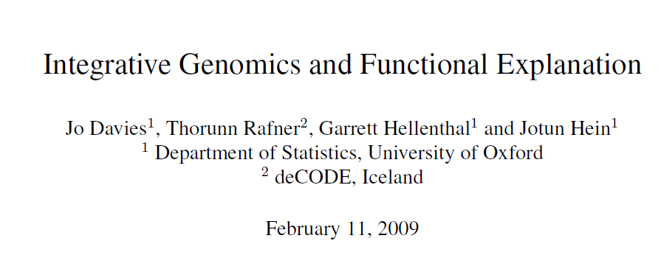
A very nice overview of integrative genomics.

Slide 5
Biological (Scientific) studies involve
Data: observations of a biological system
Concepts: provide the foundations for appropriate modelling and data interpretation
Analyses: provide the formal structure of the modelled system and the statistical framework in which models are fitted to data
II. (New) High Throughput Technologies/Data
provide understanding at different scales from genotype to phenotype (six sources):
Genome
Epigenome
Transcriptome
Proteome
Metabolome
Example
Phenome
Need for Integrative Genomics/Biology
Putting together the different levels of information/data
III. Concepts
The Central Dogma (G –> F)
(Biological) Networks
Genealogical Relationships (Evolution)
Knowledge
Hidden Structures
Data + Concepts -> Models, Analyses
IV. Analyses
Analyses of phenotype with another sources of data
Analyses of phenotype with genetic data (G+F)
Example
Integrated analysis of phenotype with at least two other sources of data
Integrated Networks
Example
V. Functional Explanation
VI. Conclusions
Notes:
# (Sylvie) Analyses:
## Analyses of phenotype with another sources of data
### Analyses of phenotype with genetic data (G + F)
#### Example
## Integrated analysis of phenotype with at least two other sources of data
### Integrated Networks
#### Example
# (Tiago) Data
## Example Metabolomics

Slide 6
II. OMICS types
- Genome (G)‏
- Epigenome (E)‏
- Transcriptome (T)‏
- Proteome (P)‏
- Metabolome (M)‏
- Phenome (F)‏
- Mettalome, lipidome, glycome, interactome, spliceome, mechanome, exposome, etc...

Slide 7
Transcriptomic
- Transcriptome is the set of all mRNA molecules (transcripts), produced in one or in a population of cells.
- Genes showing similarity in expression pattern may be functionally related and under the same genetic control mechanism.
- Information about the transcript levels is needed for understanding gene regulatory networks.
- Gene expression patterns varies according to cell type, and there is stochasticity within cell types.
- High throughput Techniques: cDNA microarrays and oligo-microarrays, cDNA-AFLP and SAGE => RNA-seq
- mRNA levels can't be measured directly due to technical and biological sources of noise (array stickiness, fluorescent dye effects and varying degrees of hybridisation)‏
- May target single-cell mRNA levels, but generally targets 100s-1000s of cells.

Slide 8
Epigenomic
- The study of epigenetics at a global scale
- Epigenetics: Heritable changes in phenotype or gene expression caused by mechanisms other than changes in DNA sequence. These changes may remain through cell divisions for the remainder of the cell's life and may also last for multiple generations.
- Main areas of study:
- Chemical modifications to DNA (methylation)‏
- Changes in DNA packaging (histone modifications)‏
- Techniques:
- Chromatin immunoprecipitation (ChIP) / ChIP-on-CHIP (microarrays)‏
(location of DNA binding sites on the genome for a particular protein)‏
=> ChIP-seq

Slide 9
Epigenomic
- Epigenetic processes are spread on the genome
- May be modified over time:
- Environmental changes (e.g. aging increases overall methylations)
- Stochasticity (copying mechanisms related to DNA methylation are 96% accurate)‏
- can be responsible for incomplete penetrance of genetic diseases
(shown for identical twins -> different phenotypes)

Slide 10
Proteomic
- Large scale study of protein structure and functions.
- Expression level of a coding gene's more direct measurement is the amount of synthesized protein.
- Proteome size is 10X greater than the # of protein coding genes (~24,000).
- # of potentially physiologically relevant protein-protein interactions is ~650,000
- Protein abundances cannot be measured directly, and single-cell global profiling is not viable.
- Techniques:
- Mass spectrometry: proteins are fragmented and all peptides in a sample are separated by their mass-charge ratio.
- 2D gel electrophoresis: Proteins are separated according to specific properties (mass, isoeletric point). Up to 10,000 spots on a gel.
- Protein arrays: based on the hybridization of proteins to specific antibodies

Slide 11
Metabolomic
- Focuses on the study of the products of cellular processes involving proteins and/or other metabolites.
- ~6500 cataloged human metabolites (may be in the order of tens of 1000s)‏
- Techniques: NMR spectroscopy, mass spectroscopy, chromatography and vibrational spectroscopes.
- Very dynamic and adaptable to environmental changes. Profiling uses multiple cells, from tissues or biofluids.

Slide 12
Phenomic
- Study and characterization of phenotypes, which represent the manifestation of interactions between genotype and the environment.
- Phenome encompasses observations of E, T, P, M and G.
- Precision and dimension of phenotype characterization has not improved as fast as other omics.
- Global phenotyping should include many measurements, e.g. morphological, biochemical, behavioral or psychological. In addition, standardized procedures are required to allow comparisons between measurements.

Slide 13
III. Concepts
The biological models and data analyses are founded on basic/general concepts
The Central Dogma of Molecular Biology (a mapping from Genotype to Phenotype)
(Biological) Networks
Genealogical Relationships (Evolution)
Knowledge
Hidden Structures
This concepts are accepted and used so frequently that they are often taken for granted and used without question
It is important to think about them

Slide 14
III. Concepts – 1. The Central Dogma (G –> F)
Genotype to phenotype mapping
focus on predicting the modification to phenotype in the presence of different genetic variants;
are very general, they rarely attempt to describe functionality.
Mapping the genome to a single phenotype is done by
breaking down the genome into regions according to a set of genetic markers
or simply by mapping a subset of genetic loci which show variation in a population.
Penetrance function: characterizes how variation at markers influences phenotype
Genetic effects are completely (or highly) penetrant for mendelian phenotypes:
P(Y=y) = I{g1=g} = 1 or 0
Complex phenotype - Incomplete/Low penetrance
phenotype is modified with probability less than 1 in the presence of a genetic variant
reflects other influences on phenotype such as other genetic, epigenetic or environmental exposures.
(general) Mapping function G –> F:
h(E(Y)) = f(g, e, x)
expectation of a phenotype Y (r. v. indirectly accounts for noise and unknown sources of variation)
for a set of genetic markers g, epigenetic factors e, and external environmental exposures x.
Functionality
Notes:
# (p13) Genotype to phenotype functions are very general, they rarely attempt to describe functionality but instead focus on predicting the modification to disease risk or phenotype in the presence of different genetic variants.
# (p13) Mapping the genome to a single phenotype is done by breaking down the genome into regions according to a set of genetic markers or simply by mapping a subset of genetic loci which show variation in a population.
# (p13) Mapping genetic markers or genomic regions to a phenotype involves characterizing how variation at markers (single or multiple) influences phenotype or risk. This involves defining a penetrance function which makes statements about phenotype conditional on genotype at a particular locus (or set of loci).
# (p14) Genetic effects are highly or completely penetrant for mendelian phenotypes such at sickle cell disease.
# (p14) Incomplete penetrance is the term used to describe instances when phenotype is modified with probability less than 1 in the presence of a genetic variant. Incomplete and low penetrance is common for complex phenotypes and is reflective of other influences on phenotype such as other genetic, epigenetic or environmental exposures.
# (p14) A statement about the mode of inheritance of a phenotype can be implicitly defined by the mapping function, that is, how phenotype is transmitted from one generation to another (assuming no de novo mutations). This is difficult to define for complex phenotypes affected by multiple genetic loci and other factors, but for single gene/locus phenotypes, dominant, recessive and additive modes of inheritance can be well defined and modelled.

Slide 15
III. Concepts – 2. (Biological) Networks [1/2]
Networks attempt to provide a more functional explanation by involving quantities at the molecular/celular level.
Networks use approximations to reduce the problems (e.g. 10^41 –> 10^5):
Molecular Approximations:
Biomolecules represented by their observed abundance e.g. a gene represented by its observed mRNA expression level.
Nodes (labelled with genes for example) considered ‘on’ or ‘off’.
Physical interactions between molecules considered to be ‘present’ or ‘absent’.
Many molecules excluded, either because they are unobserved or not considered important to the system being modelled.
Temporal Approximations:
Single snap shot observations of data to construct networks representative of a system at a single point in time (usually assumed to be in a steady state).
Dynamical systems approximated by a few charateristics such as rate parameters in a system of ordinary or stochastic differential equations.
Dynamical systems approximated according to obervations at a discrete set of time points appropriately chosen according to the time scale of the system of study.
Notes:
# (p13) Networks are again models, but they attempt to provide a more functional explanation by involving quantities that can be interpreted at the molecular level.
# (p15) … a complete description of the human system is of order 10^{41} atomic positions per second. Human systems are decomposed according to different tissues, cells and processes
yet even these subsystems are (at most) represented by networks involving 10^3 − 10^5 nodes and edges. The reduction of at least 36 orders of magnitude is founded on substantial molecular and temporal approximations:
## 1. Molecular Approximations:
### • Biomolecules represented by their observed abundance e.g. a gene represented by its observed mRNA expression level.
### • Nodes (labelled with genes for example) considered ‘on’ or ‘off’.
### • Physical interactions between molecules considered to be ‘present’ or ‘absent’.
### • Many molecules excluded, either because they are unobserved or not considered important to the system being modelled.
## 2. Temporal Approximations:
### • Single snap shot observations of data to construct networks representative of a system at a single point in time (usually assumed to be in a steady state).
### • Dynamical systems approximated by a few charateristics such as rate parameters in a system of ordinary or stochastic differential equations.
### • Dynamical systems approximated according to obervations at a discrete set of time points appropriately chosen according to the time scale of the system of study.
# (p15-16) There are four well established types of biological network (N1-N4) which aim to approximate the processes determining function and phenotype at a cellular level.
## N1 Protein Interaction Networks - Nodes are labelled with proteins and edges are representative of a physical interaction.
## N2 Signal Transduction Networks - Nodes are labelled with signals, e.g. hormones, proteins and edges represent biochemical processes by which the signals are transferred and converted to other signalling molecules. Since the processes occur in sequence the resulting networks are often referred to as cascades.
## N3 Gene/Transcription Regulatory Networks - Nodes are labelled with gene transcripts and in some cases known transcription factors. Edges are representative of transcription regulatory mechanisms for example transcription factor binding.
## N4 Metabolic Pathways - Nodes are labelled with metabolites and edges represent chemical reactions. Since many reactions require catalysis by additional molecules (such as enzymes), edges may involve more than two nodes thereby creating a hypergraph.
# (p17) The strategies used to reconstruct biological networks vary according to the existing biological knowledge and data upon which they are founded. They can be classified into three categories accordingly:
## 1. Theoretical Modelling: This approach is based on existing biological knowledge (perhaps obtained via literature searches) and chemical/ physical laws (such as the law of mass action). No data in its raw form is used. This approach is successful for dynamic modelling of signalling pathways, transcriptional regulatory networks and metabolic pathways. It can also be used to make predictions of protein-protein interactions on the basis of the properties of the proteins rather than observations of physical interactions.
## 2. Physical Interaction Modelling: The nodes and edges of these networks are defined by the data. Edges are inserted between two nodes if they are observed to physically interact. This approach is usually only used to reconstruct static protein-protein interaction networks.
## 3. Statistical Modelling: This approach uses observations of data at the nodes of a network to infer edges. There are a range of statistical techniques which can be used to infer networks at a single snap shot in time or dynamic networks over a range of time points. This approach can be effective for both small and large data sets. In addition, statistical modelling can also be used in conjunction with theoretical models to provide a more detailed description of a system. For example, data could be used to infer rate parameters of a metabolic reaction.
# We continue to describe the concepts and techniques used in theoretical and statistical modelling since these are used for the interpretation of global variation data sets.

Slide 16
III. Concepts – 2. (Biological) Networks [2/2]
There are four well established types of biological network which (approximately) determine function and phenotype at a cellular level.
Protein Interaction, Signal Transduction, Gene/Transcription Regulatory, and Metabolic Pathways Networks
Biological networks are (re)constructed according to the existing biological knowledge and data – two categories are used for the interpretation of global variation data sets:
Theoretical Modelling
based on existing biological knowledge and physical/chemical laws;
no data in its raw form is used;
is successful for dynamic modelling of signalling pathways, transcriptional regulatory networks and metabolic pathways.
Statistical Modelling
uses observations of data at the nodes to infer edges;
a range of statistical techniques can be used to infer networks
at a single snap shot in time or
dynamic networks over a range of time points;
can be effective for both small and large data sets;
can also be used in conjunction with theoretical models to provide a more detailed description of a system (e.g. to infer rate parameters of a metabolic reaction)
Notes:
# (p13) Networks are again models, but they attempt to provide a more functional explanation by involving quantities that can be interpreted at the molecular level.
# (p15) … a complete description of the human system is of order 10^{41} atomic positions per second. Human systems are decomposed according to different tissues, cells and processes
yet even these subsystems are (at most) represented by networks involving 10^3 − 10^5 nodes and edges. The reduction of at least 36 orders of magnitude is founded on substantial molecular and temporal approximations:
## 1. Molecular Approximations:
### • Biomolecules represented by their observed abundance e.g. a gene represented by its observed mRNA expression level.
### • Nodes (labelled with genes for example) considered ‘on’ or ‘off’.
### • Physical interactions between molecules considered to be ‘present’ or ‘absent’.
### • Many molecules excluded, either because they are unobserved or not considered important to the system being modelled.
## 2. Temporal Approximations:
### • Single snap shot observations of data to construct networks representative of a system at a single point in time (usually assumed to be in a steady state).
### • Dynamical systems approximated by a few charateristics such as rate parameters in a system of ordinary or stochastic differential equations.
### • Dynamical systems approximated according to obervations at a discrete set of time points appropriately chosen according to the time scale of the system of study.
# (p15-16) There are four well established types of biological network (N1-N4) which aim to approximate the processes determining function and phenotype at a cellular level.
## N1 Protein Interaction Networks - Nodes are labelled with proteins and edges are representative of a physical interaction.
## N2 Signal Transduction Networks - Nodes are labelled with signals, e.g. hormones, proteins and edges represent biochemical processes by which the signals are transferred and converted to other signalling molecules. Since the processes occur in sequence the resulting networks are often referred to as cascades.
## N3 Gene/Transcription Regulatory Networks - Nodes are labelled with gene transcripts and in some cases known transcription factors. Edges are representative of transcription regulatory mechanisms for example transcription factor binding.
## N4 Metabolic Pathways - Nodes are labelled with metabolites and edges represent chemical reactions. Since many reactions require catalysis by additional molecules (such as enzymes), edges may involve more than two nodes thereby creating a hypergraph.
# (p17) The strategies used to reconstruct biological networks vary according to the existing biological knowledge and data upon which they are founded. They can be classified into three categories accordingly:
## 1. Theoretical Modelling: This approach is based on existing biological knowledge (perhaps obtained via literature searches) and chemical/ physical laws (such as the law of mass action). No data in its raw form is used. This approach is successful for dynamic modelling of signalling pathways, transcriptional regulatory networks and metabolic pathways. It can also be used to make predictions of protein-protein interactions on the basis of the properties of the proteins rather than observations of physical interactions.
## 2. Physical Interaction Modelling: The nodes and edges of these networks are defined by the data. Edges are inserted between two nodes if they are observed to physically interact. This approach is usually only used to reconstruct static protein-protein interaction networks.
## 3. Statistical Modelling: This approach uses observations of data at the nodes of a network to infer edges. There are a range of statistical techniques which can be used to infer networks at a single snap shot in time or dynamic networks over a range of time points. This approach can be effective for both small and large data sets. In addition, statistical modelling can also be used in conjunction with theoretical models to provide a more detailed description of a system. For example, data could be used to infer rate parameters of a metabolic reaction.
# We continue to describe the concepts and techniques used in theoretical and statistical modelling since these are used for the interpretation of global variation data sets.

Slide 17
III. Concepts – 3. Genealogical Relationships (Evolution)
Models of evolution are important to characterise the uncertainty over possible genealogies consistent with the data
Genomic variation can be observed at three levels:
Across cells within an individual
related by ontogenic tree
Across individuals within a population
related by a pedigree
Across species
related by a phylogeny.
Rate of genomic variation in the human-mouse
between species genomes: 1 in 50 nucleotides;
between two individuals genomes: 1 in 1000 (200) nucleotides;
between two cells genomes: 1 in 10^7-10^8 nucleotides.
(Genomes change at the) three categories of evolution provide different sources of information:
Species level: ideal for measuring rates and selection
Population level: give the functional interpretation of the actual content of the genome in terms of molecular mechanism
Cell level: mainly used on cancer studies
due to the intense interest in this disease and fast chromosomal evolution in cancer cells.
Basic rates of evolutionary events allow us to understand the mechanism of organismal change:
The strength and direction of selection can be a consequence of genome function.
In particular, regions under positive selection experience an increased rate of evolution relative to neutrality
and can be indicative of functional regions which adapt to environment.
Notes:
# (p13) Contrary to genotype to phenotype functions and networks which both provide approximations to true mechanisms, true genealogies relating cells, individuals and species exist and could be exploited effectively if they could be observed. In practise, this is rarely possible, so models of evolution are important to characterise the uncertainty over possible genealogies consistent with the data.
# (p21) Genomic variation can be observed at three levels:
## 1. Across cells within an individual: All cells in an individual are related by an ontogenic tree.
## 2. Across individuals within a population: All individuals in a population are related by a pedigree. In most cases, the pedigree relating individuals of a population is not of primary interest but rather how genomes are related. This information can be represented by an ancestral recombination graph (ARG).
## 3. Across species: Species are related by a phylogeny - at times with some loops due to hybridization or horizontal transfer.
# (p21) Full genomic sequencing efforts initially targeted genomes at the species level, particularly those known with many genomic differences. Population genomic variation followed and is currently typically observed at a subset of markers in the genome rather than in its entirety. Finally there is genomic variation observed at a cellular level where relatively few differences are expected between cells sampled from the same individual. In the mousehuman example, there would roughly be a difference every 50 nucleotides between the species genomes, one difference in every 1000 nucleotides in two population genomes and possibly a difference every 107-108 nucleotides for cellular genomes.
# (p21) Species and individual variation contribute rich source of information which can be of central use in integrative genomics. For example, population based studies can exploit the genealogy relating individuals and similarly, comparative studies can exploit differences between species. However, despite the fact that most current high throughput technologies make observations on cellular quantities, cellular relationships within an individual are rarely explicitly used.
# (p21) The three categories of evolution described in this section provide different sources of information. Genomes change at the species level is ideal for measuring rates and selection. Genomes at the population level have correlations (linkage disequilibrium) along it sequences making genetic mapping possible.
# (p21-22) 3.3.1 Genealogies relating cells in an individual
## Only few studies have been undertaken of cell phylogenies, but this will change. In contrast, cancers have been studied extensively due to the intense interest in this disease and fast chromosomal evolution in cancer cells.
# (p22) The main contributions of genome evolution can be considered in three categories: (1) the observation of basic rates of events, (2) the identification of regions under selection and (3) the functional interpretation of the actual content of the genome in terms of molecular mechanism. Basic rates of evolutionary events (such as mutation or recombination) are of intrinsic value in understanding the mechanism of organismal change. The strength and direction of selection are of great interest since it can be a consequence of genome function. Regions under negative (also termed purifying) selection evolve at a decreased rate relative to neutrality. They are of interest because they can be indicative of genome function, which has substantial effect on fitness. Conversely, regions under positive selection experience an increased rate of evolution relative to neutrality. Although they are less prevelant than negatively selected regions, they are also of great interest to study since they can be indicative of functional regions which adapt to environment.

Slide 18
III. Concepts – 4. Knowledge (and Hidden Structures)
All studies are founded on a certain level of biological knowledge
True facts (P=1) & facts with a uncertainty degree (Bayesian framework)
Confirmed/Indicated by experiment results
The other concepts described in this section are also founded on biological knowledge that is accepted to be true
the central dogma underpins the concept of a mapping from genotype to phenotype,
knowledge of biomolecules which physically interact motivate development of network models,
knowledge about evolutionary processes motivates the use of genealogies.
Furthermore, knowledge that there are hidden structures present in data motivates development of (statistical) models to infer these unobserved states.
The increasing numbers of studies of biological variation, necessitates the development of a consistent representation of knowledge and tools to efficiently exchanged it
There are several tools for cataloguing and collating knowledge
Ontologies and Databases
Systems Biology markup languages
Process Algebras
Text Mining Methods
Notes:
KNOWLEDGE
# (p13) All studies are founded on a certain level of biological knowledge and as research studies continue to exploit high throughput experimental techniques, representation and exchange of knowledge is becoming increasingly important.
# (p23) Without exception, all studies of global biological variation exploit existing knowledge to some degree and yet defining what consistutes ‘knowledge’ is difficult; i.e. how do you know when you know something? Coupling knowledge with a measure of uncertainty provides one way of resolving this question although defining this measure of uncertainty is also non-trivial. The Bayesian framework provides the structure to coherently incorporate uncertainty about knowledge into a model by representing it using a probability distribution. This probability distribution can then be updated given observed data and where necessary averaged over to make statements about a quantity of interest.
# (p23) In any given study, there is usually a set of things which are assumed to be true (with probability 1). These are usually experimentally tested and validated by multiple researchers independently and generally accepted by the scientific community to be facts. They vary according to the study but usually strongly influence study design and data collection (table 3), with some also providing the foundations for model construction and analysis.
# (p23) In particular, the other concepts described in this section are also founded on biological knowledge that is accepted to be true; the central dogma underpins the concept of a mapping from genotype to phenotype, knowledge of biomolecules which physically interact motivate development of network models, and knowledge about evolutionary processes motivates the use of genealogies. Furthermore as we go on to describe, knowledge that there are unobserved structures present in data (all types but particularly sequence data) motivates development of models to infer these unobserved states.
# (p23-24) The increasing numbers of studies of biological variation, necessitates the development of a consistent representation of knowledge and tools such that it can be efficiently exchanged between researchers. There are several tools for cataloguing and collating knowledge (K1-4)
## K1 Ontologies and Databases: Ontologies are structured databases which aim to provide a consensus vocabulary for knowledge exchange. The most famous example is Gene Ontology (GO) which aims to describe gene function. They are typically organised as a tree or DAG reflecting natural nested structure of terms [11, 7, 48]. Other databases also exist with differing levels of structure
## K2 Systems Biology markup languages: These provide a set of conventions for how to formulate models to be exchanged and allowing computer parsing. It is based on a more general set of conventions called eXtensible Markup Language (XML). First versions were publically available in 2003 and have since seen version 2.0 with extended flexibility. At present it is directed towards cellular biochemical models and does not place restrictions on the language in which the model is formulated (such as MatLab or MATHEMATICA).
## K3 Process Algebras: These are disciplines of formal computer science which are devoted to the description and analyses of processes. Examples include p-calculus, lambda calculus, PEPA and Petri Nets. Although they are founded on theory, process algebras have many biologically realistic properties such as allowing process interaction and refinement of descriptions. In particular, Calder et al. [15] and Phillips and Cardelli [97] use process algebras for automating ordinary differential equation models for simple biological systems. Potentially they could become a very powerful tool for systems biology although they currently lack flexibility to incorporate several continuous features necessary in biological models, such as space and concentration [16, 5, 98, 3, 77].
## K4 Text Mining Methods: These are automated techniques which extract information in a coarse manner from large bodies of text which could not be read by a single researcher. They are based on the simple underlying principle that words in articles can be tabulated according to frequency, contextuality, combinations, information content and more. This very efficiently allows linking genes with genes, biological objects with sets of properties and much more. The widespread use of text mining shows that in the large body of articles information is encoded in a way that is not detectable by simple sequential reading of a smaller set of articles. Text mining is progressing fast and with the increased use of ontologies and associated well-defined terms, text mining will increasingly acquire abilities closer to traditional reading [105].
HIDDEN STRUCTURES:
# (p13) NÃO há nada interessante na parte introdutória dos Conceitos (3. Concepts)!
# (p24) It is very fundamental aspect of biology that one can observe certain quantities that are a function of something that cannot be observed. This is inherent in statistical modelling where there is often a hidden model that generates observables and we try to make statements about the hidden model. The last two decades have seen this taken a step further in the statistical model itself have been split into a hidden part that influence a part that generates the observables. It is a very general principle inherent in the way inference is done in biology. The most famous example is the class of hidden Markov models that now are ubiquitous and have very widespread applications in the biosciences.
# Modelling via hidden elements is very natural and will most likely grow tremendously in the future. The applications so far are very simple, where the hidden element is unambiguous. It is easy to imagine more complex models, such as more interacting cellular components or a large set of possible networks relating the observables.

Slide 19
IV. Which classes are often combined in analysis?
1 - Analysis of single sources of data
1.1 -Species Level Genomic Variation Data; (G)
1.2 -Human Genetic Variation Data; (G)
1.3- Molecular Quantities; (T), (M), (P)
2- Analysis of phenotype with another source of data
2.1 Analysis of phenotype with genetic data; (G+F)
2.2 Analysis of phenotype with molecular data; (F + T), (F + P), (F + M)
2.3 Analysis of genetic data with molecular data; (G + T), (G + P), (G + M)
3- Analysis with multiple molecular data types; (T + P), (T + M), (M + P), (T + P + M)
4- Integrated analysis of phenotype with at least two other sources of data
4.1 -Comparing genetic associations with different phenotypes
4.2- Integrated Networks
5- Analysis of all data types across multiple species

Slide 20
Integrated analysis of phenotype with at least two other sources of data
Two ways in which data sources can be combined
Analyzed separately
and then compared
Analyzed simultaneously
Comparing genetic associations with different phenotypes
Integrated Networks
Use a mixture of the concepts, clearly founded on the concept of a network but they also draw on existing biological knowledge and the idea of a mapping from G → F

Slide 21
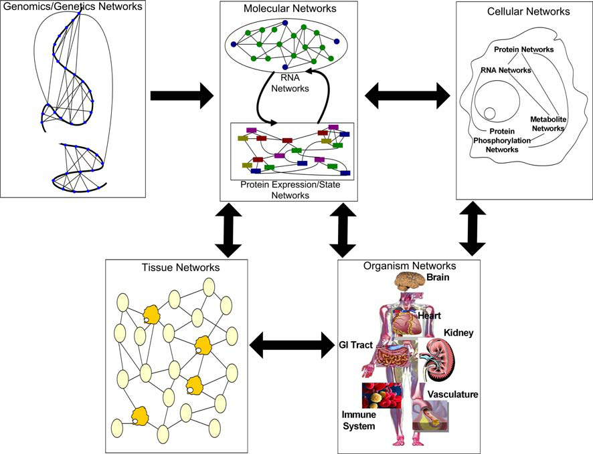
Integrated Networks
High-level view of the flow of information in biological systems through a hierarchy of networks
(Sieberts et al, Mamm Genome, 2007)
IN aimed at processing high-dimensional biological data by integrating data from multiple sources, and can provide a path to inferring causal associations between genes and disease.
Notes:
See legend of fig 1 to explain

Slide 22
VI. Conclusions
We have talked about: Data, Concepts, Analyses
The goal of biosciences: Full understanding and predictive modelling of biological systems
But the global genome-wide studies describe systems of a size that cannot be modelled to this level in the foreseeable future.
Functional interpretation is attempted by integrative studies and systems biology but both of these techniques are still too high level to provide full functional explanations at a molecular or atomic level.
This level of understanding will be the result of bottom-up approaches which provide a more detailed understanding of smaller systems or fewer genes.
We are presently seeing the rise of high throughput studies.
The near future will probably see Mathematical Modelling being important to everyone.
and/or advances on Integrative Biology (top-down) & Systems Biology (bottom-up) and its relations
Notes:
# (p42) In this review, we distinguish data, concepts, and analyses as the major components of studies of biological variation. Ideally they should be clearly outlined prior to performing an experiment or gathering data, although in practise many researchers observe data before giving consideration to the concepts and analytical techniques to interpret it.
# Full understanding and predictive modelling of biological systems are the ultimate goals of research in the biosciences but the global genome-wide studies describe systems of a size that cannot be modelled to this level in the foreseeable future. While they have been, and will continue to be, tremendously useful in coarse functional assignments of genes, they cannot lead to detailed understanding of biological systems. This level of understanding will inevitably be the result of bottom-up approaches which provide a more detailed understanding of smaller systems or fewer genes.
# Directly or indirectly, most funding for research in the biosciences is motivated by the hope of alleviating human disease. The overall trajectory of disease research might be:
## Association Mapping -> Fine Mapping -> Functional Interpretation -> Intervention/ Drug Development
# The first two steps are routinely employed within the framework we describe. Functional interpretation is attempted by integrative studies and systems biology but both of these techniques are still too high level to provide full functional explanations at a molecular or atomic level. This level of explanation is achieved largely by highly focused laboratory experiments with statistics playing a small role relative to the techniques employed to analyse global, high throughput biological data sets. The final step ‘Intervention/ Drug Development’ is already a well established field despite the fact that there are very few functional explanations of complex disease which start with genetics. Consequently, it requires huge resources.
# Many new data types, such as medical imaging, relating to tissues and organs will be of increasing relevance and already have proved valuable in the study of model organisms.
# We are presently seeing the rise of high throughput studies. The near future will probably see mathematical modelling being important to everyone.

Slide 23
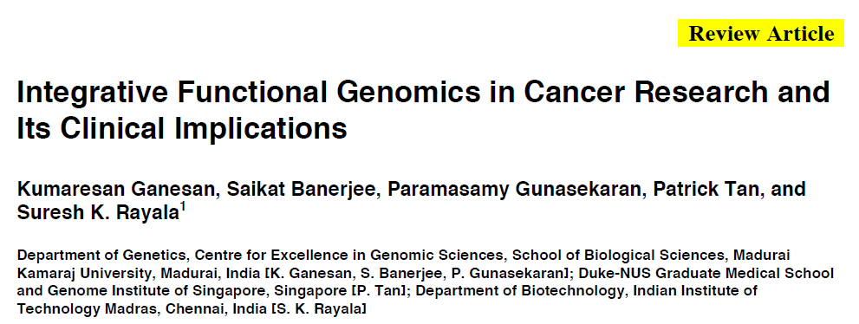

Slide 24
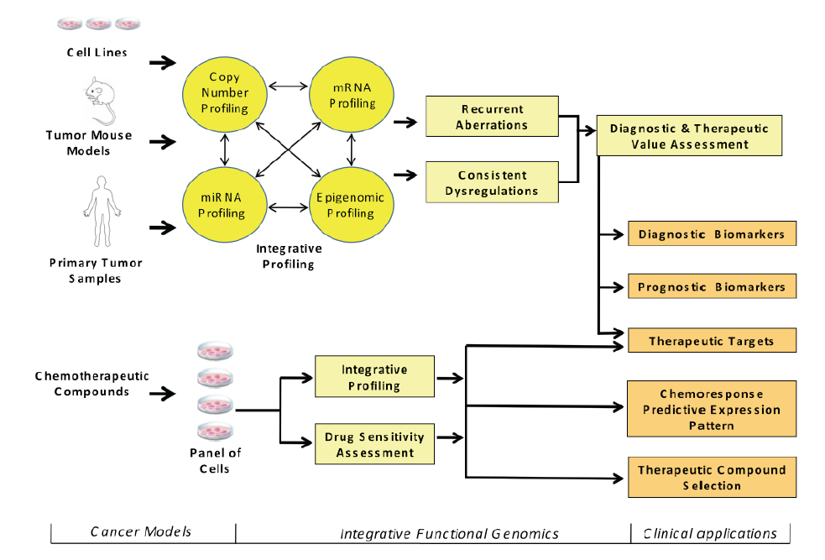

Slide 25
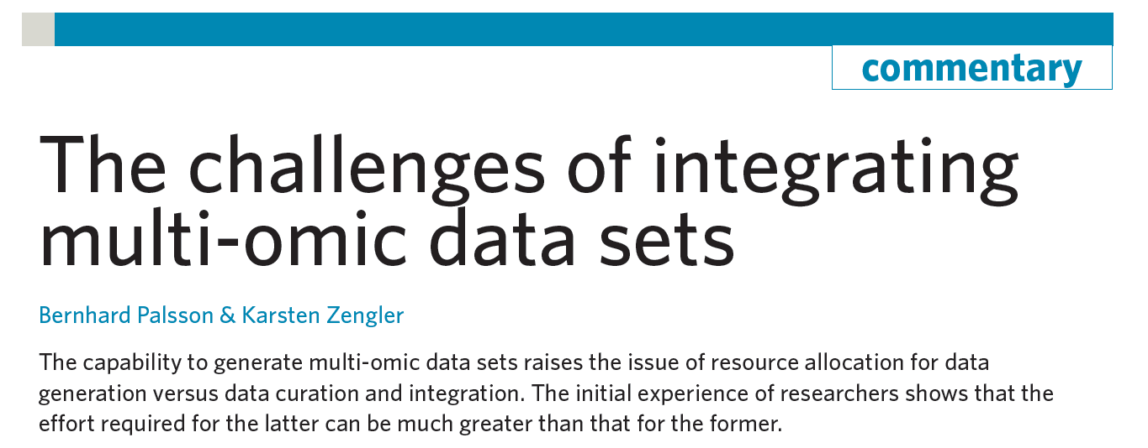
What’re the new challenges?

Slide 26
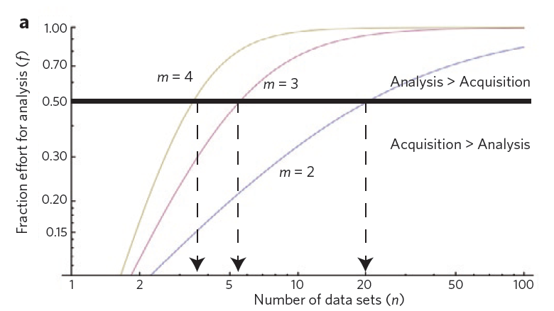
m: number of omics data types (transcriptome, CNV, proteome…)
n: number of data sets or conditions
f: fraction of effort for analysis

Slide 27
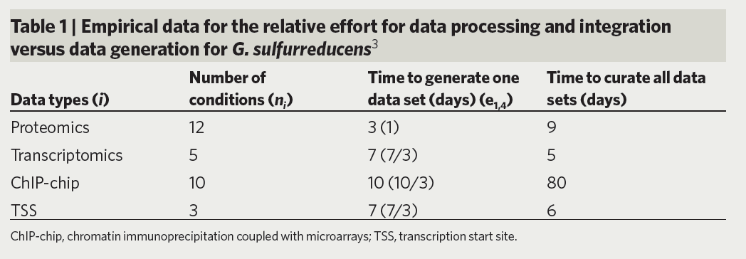
The authors stated in several of their experiences, f=0.67-0.75. (i.e. For f=0.7, if you spend 30 days to generate the data, you’ll need 70 days to perform data analysis and integration).
In Table 1, m=4 and (n1,n2,n3,n4)=(12,5,10,3). f=0.65.

Slide 28
What’s the implication:
Most projects based on multi-omics data generation focus majority of resources to data generation.
Need better resource allocation and planning on the data analysis plan before data generation.
Lack of qualified personnel to perform multi-omics data analysis and integration:
Ability of programming and statistical analysis
Experience in genomic data analysis (e.g. normalization and modeling)
Understanding of quantitative and qualitative relationship of different omics data types.

Slide 29
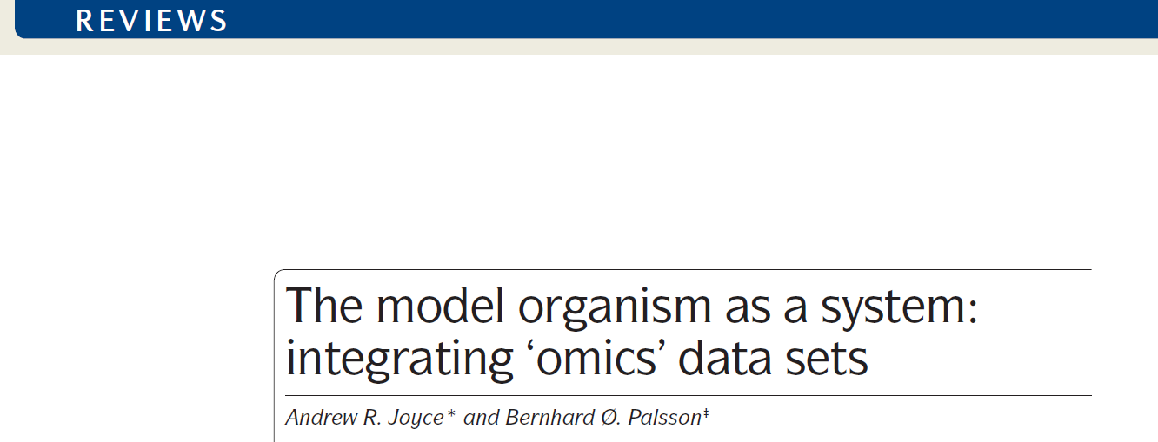
A review paper on omics data integration (more on systems biology perspective)

Slide 30
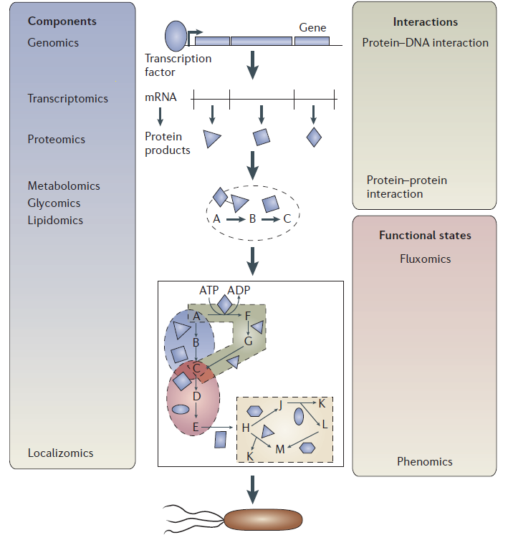

Slide 31
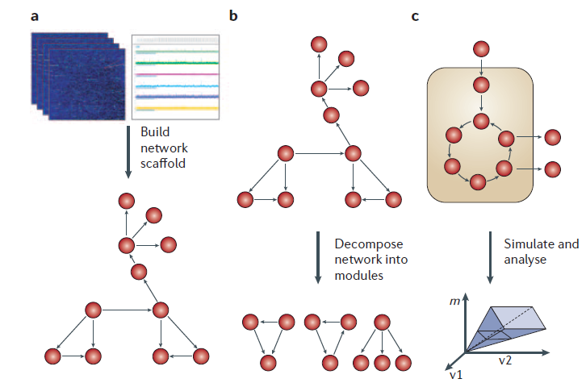

Slide 32
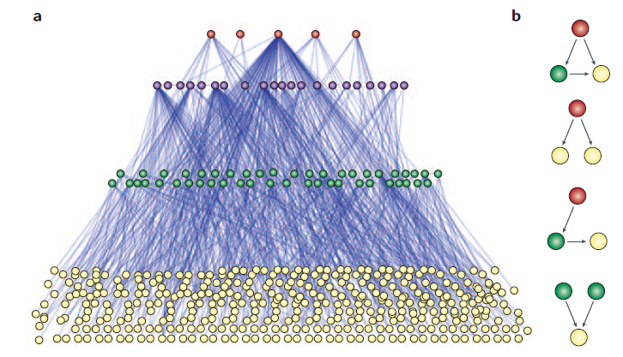

Slide 33
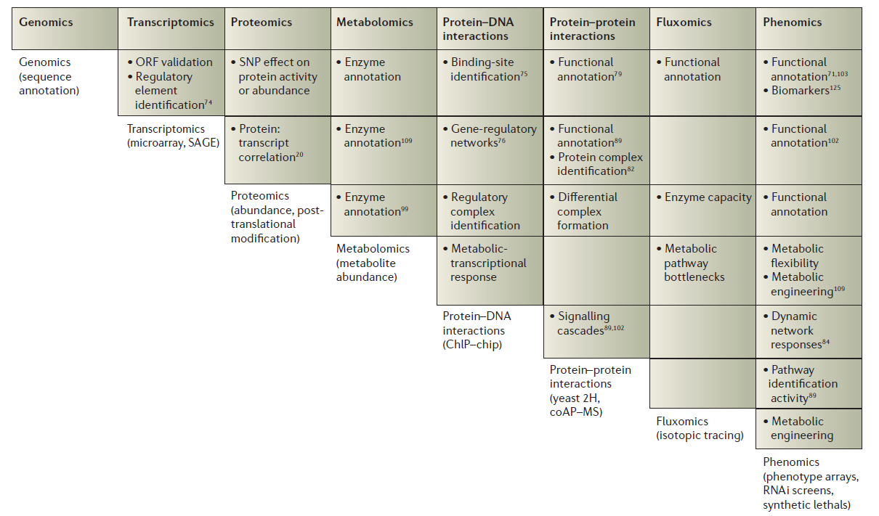

Slide 34
Three case studies:
Naïve integrative analysis: Separate analysis on each omics data and ad hoc integration of the results.
Sequential biological design: discovery/validation and pursue of specific hypotheses
Full statistical modeling: A unified model incorporating biological prior concept and observed omics data. Can be Bayesian or non-Bayesian.

Slide 35
Case study 2

Slide 36
Case study 2

Slide 37
Case study 2

Slide 38
Case study 2

Slide 39
Case study 2

Slide 40
Case study 2

Slide 41
Case study 2

Slide 42
Case study 2

Slide 43
Case study 2

Slide 44
Case study 2

Slide 45
Case study 2

Slide 46
Case study 2

Slide 47
Case study 2

Slide 48
Case study 2

Slide 49
Case study 2

Slide 50
Case study 2

Slide 51
Case study 2

Slide 52
Case study 2
Comments:
This case study mostly use commercial software for convenience.
CNV and gene expression data are analyzed separately and finally combined for comparison and inference.
This is the most naïve and straightforward integrative analysis.

Slide 53
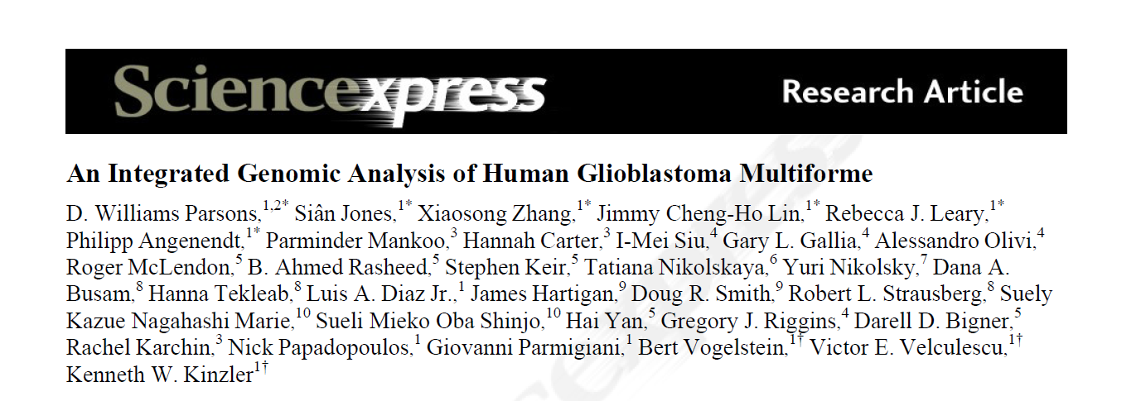
Case study 1

Slide 54
Case study 1
Targeted sequencing of 20,661 protein coding genes on 22 human GBM samples.
Copy number variation analysis using Illumina SNP arrays on the same 22 samples.
SAGE and next-generation sequencing to analyze gene expression.

Slide 55
Case study 1
Protein-coding gene sequencing
Discovery phase: Identified 993 somatic mutations (in 685 genes) in at least one of the 22 samples.
Validation phase: Follow up 21 mutated genes in an additional 83 GBMs. 16 of the 21 mutations were identified in the additional samples.
Copy number variation
CNV analysis identified 147 amplifications and 134 deletions.

Slide 56
Case study 1
Integration of mutation info and CNV data
Passenger mutation rates are estimated from average of “lower” bound (from HapMap database) and “upper” bound (from highly mutated known driver genes, such as TP53, PTEN and RB1).
Use likelihood ratio test (LRT) to estimate the passenger probability of each gene. In LRT, the null hypothesis is that the mutation rate is the same as the passenger mutation rate. If a gene is rejected, it is a GBM candidate cancer gene (CAN-gene; i.e. a candidate driver gene).

Slide 57
Case study 1
Detected CAN-genes included several genes related to gliomas: TP53, PTEN, CDKN2A, RB1, EGFR, NF1, PIK3CA and PIK3R1.
Functional and network analyses were performed on the CAN-genes.
Gene expression analysis identified DE genes and found enrichment in the same pathways.
Identified IDH1 that was not associated with GBMs.
Further detailed analysis on IDH1 was performed.

Slide 58
Comments
Case study 1
Discovery/validation strategy to screen for markers
Combine CNV and somatic mutation to infer driver genes.
Knowledge-driven analysis to fish out novel associated genes.

Slide 59
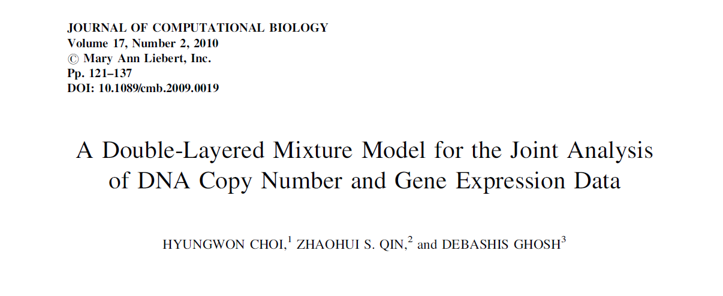
Case study 3
A full statistical model (Bayesian approach) to jointly analyze CNV and gene expression data.

Slide 60
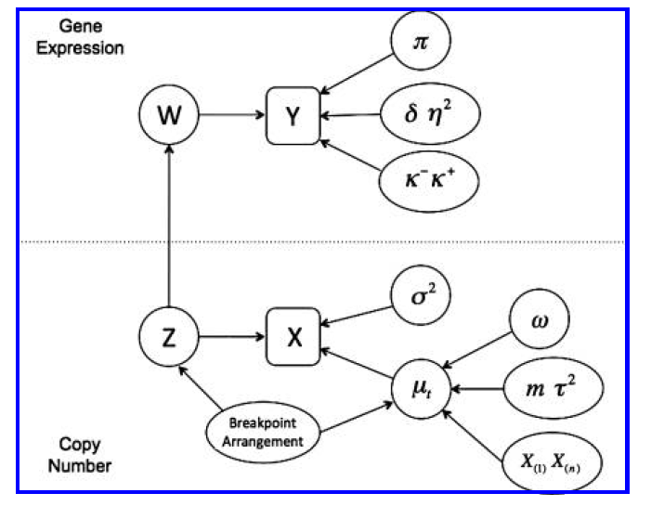
Case study 3
X: observed CNV intensities (normalized).
Z: inferred CNV status
Y: observed gene expression intensities (normalized)
W: inferred differential expression (DE) status

Slide 61
Copy number variation component:
Case study 3

Slide 62
Gene expression component:
Case study 3

Slide 63
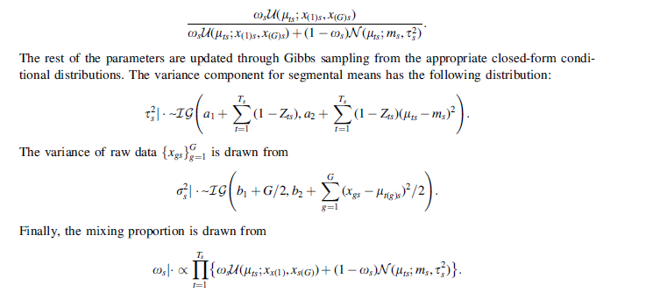
Case study 3

Slide 64
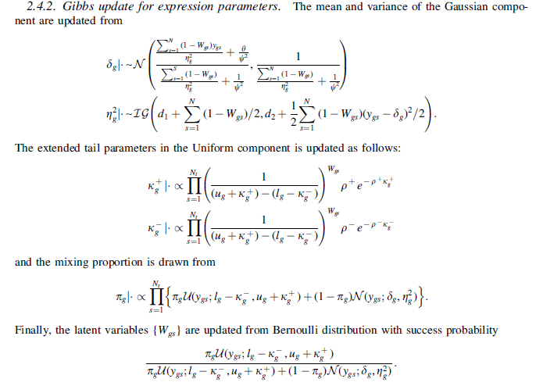
Case study 3

Slide 65
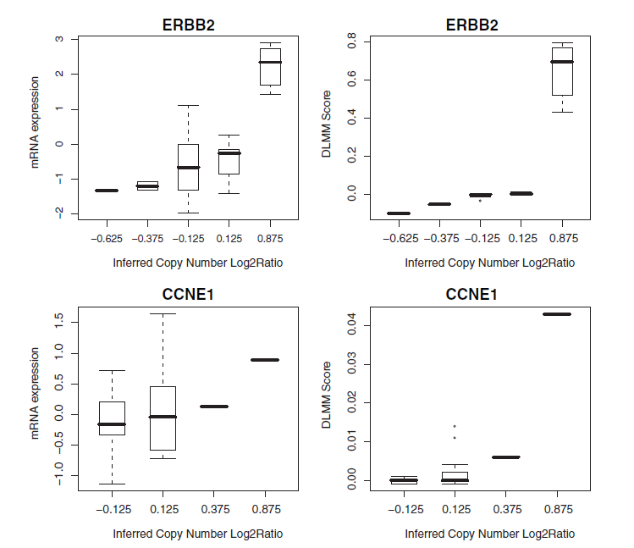

Slide 66
Comments
Case study 3 presents an example of full statistical model to integrate two –omics data (CNV and gene expression)
Full Bayesian approach
Pros: rigorous statistical inference to identify gene expression changes caused by CNV.
Cons: Computation and extensibility to other data types. Every integrative analysis (different types of omics data and biological objectives) needs custom-made statistical model.

